Slide 1
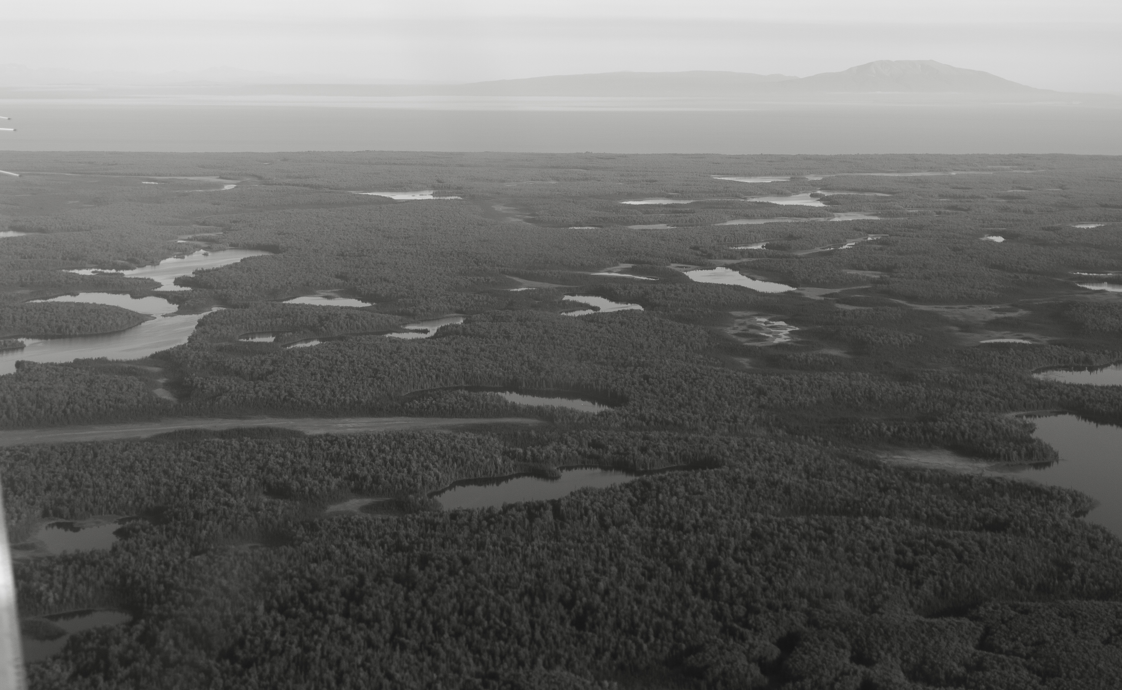
Spatiotemporal trends in salmon metapopulation contributions to portfolio effects in Western Alaska
Ben Makhlouf

Slide 2
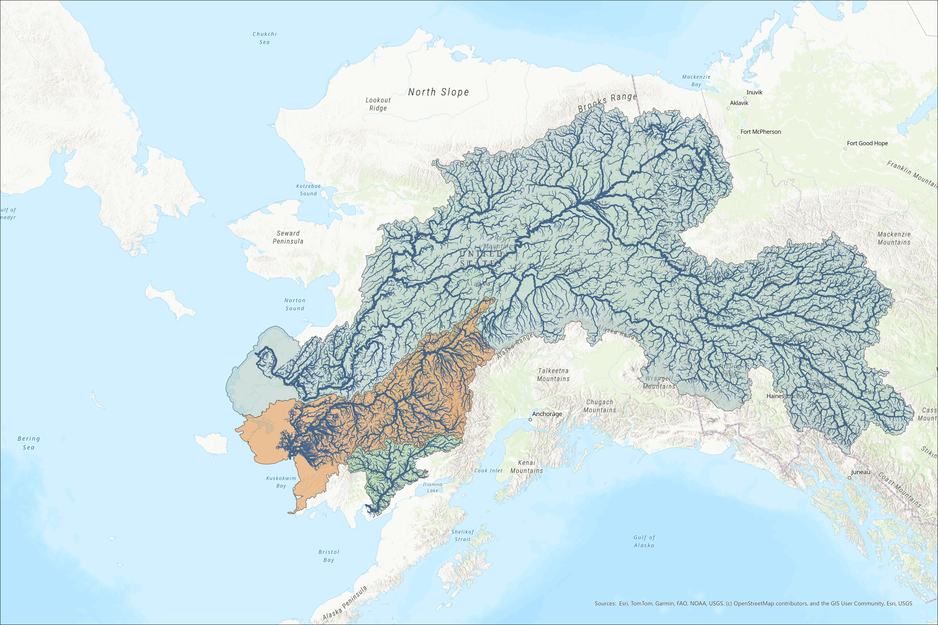


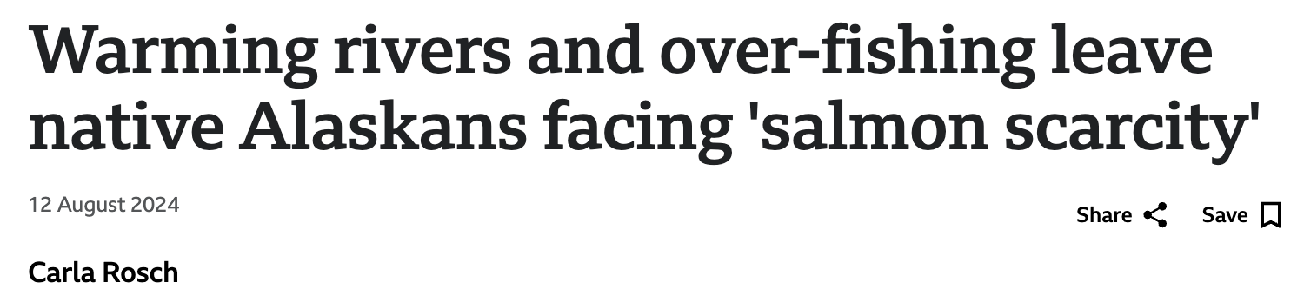

Slide 3
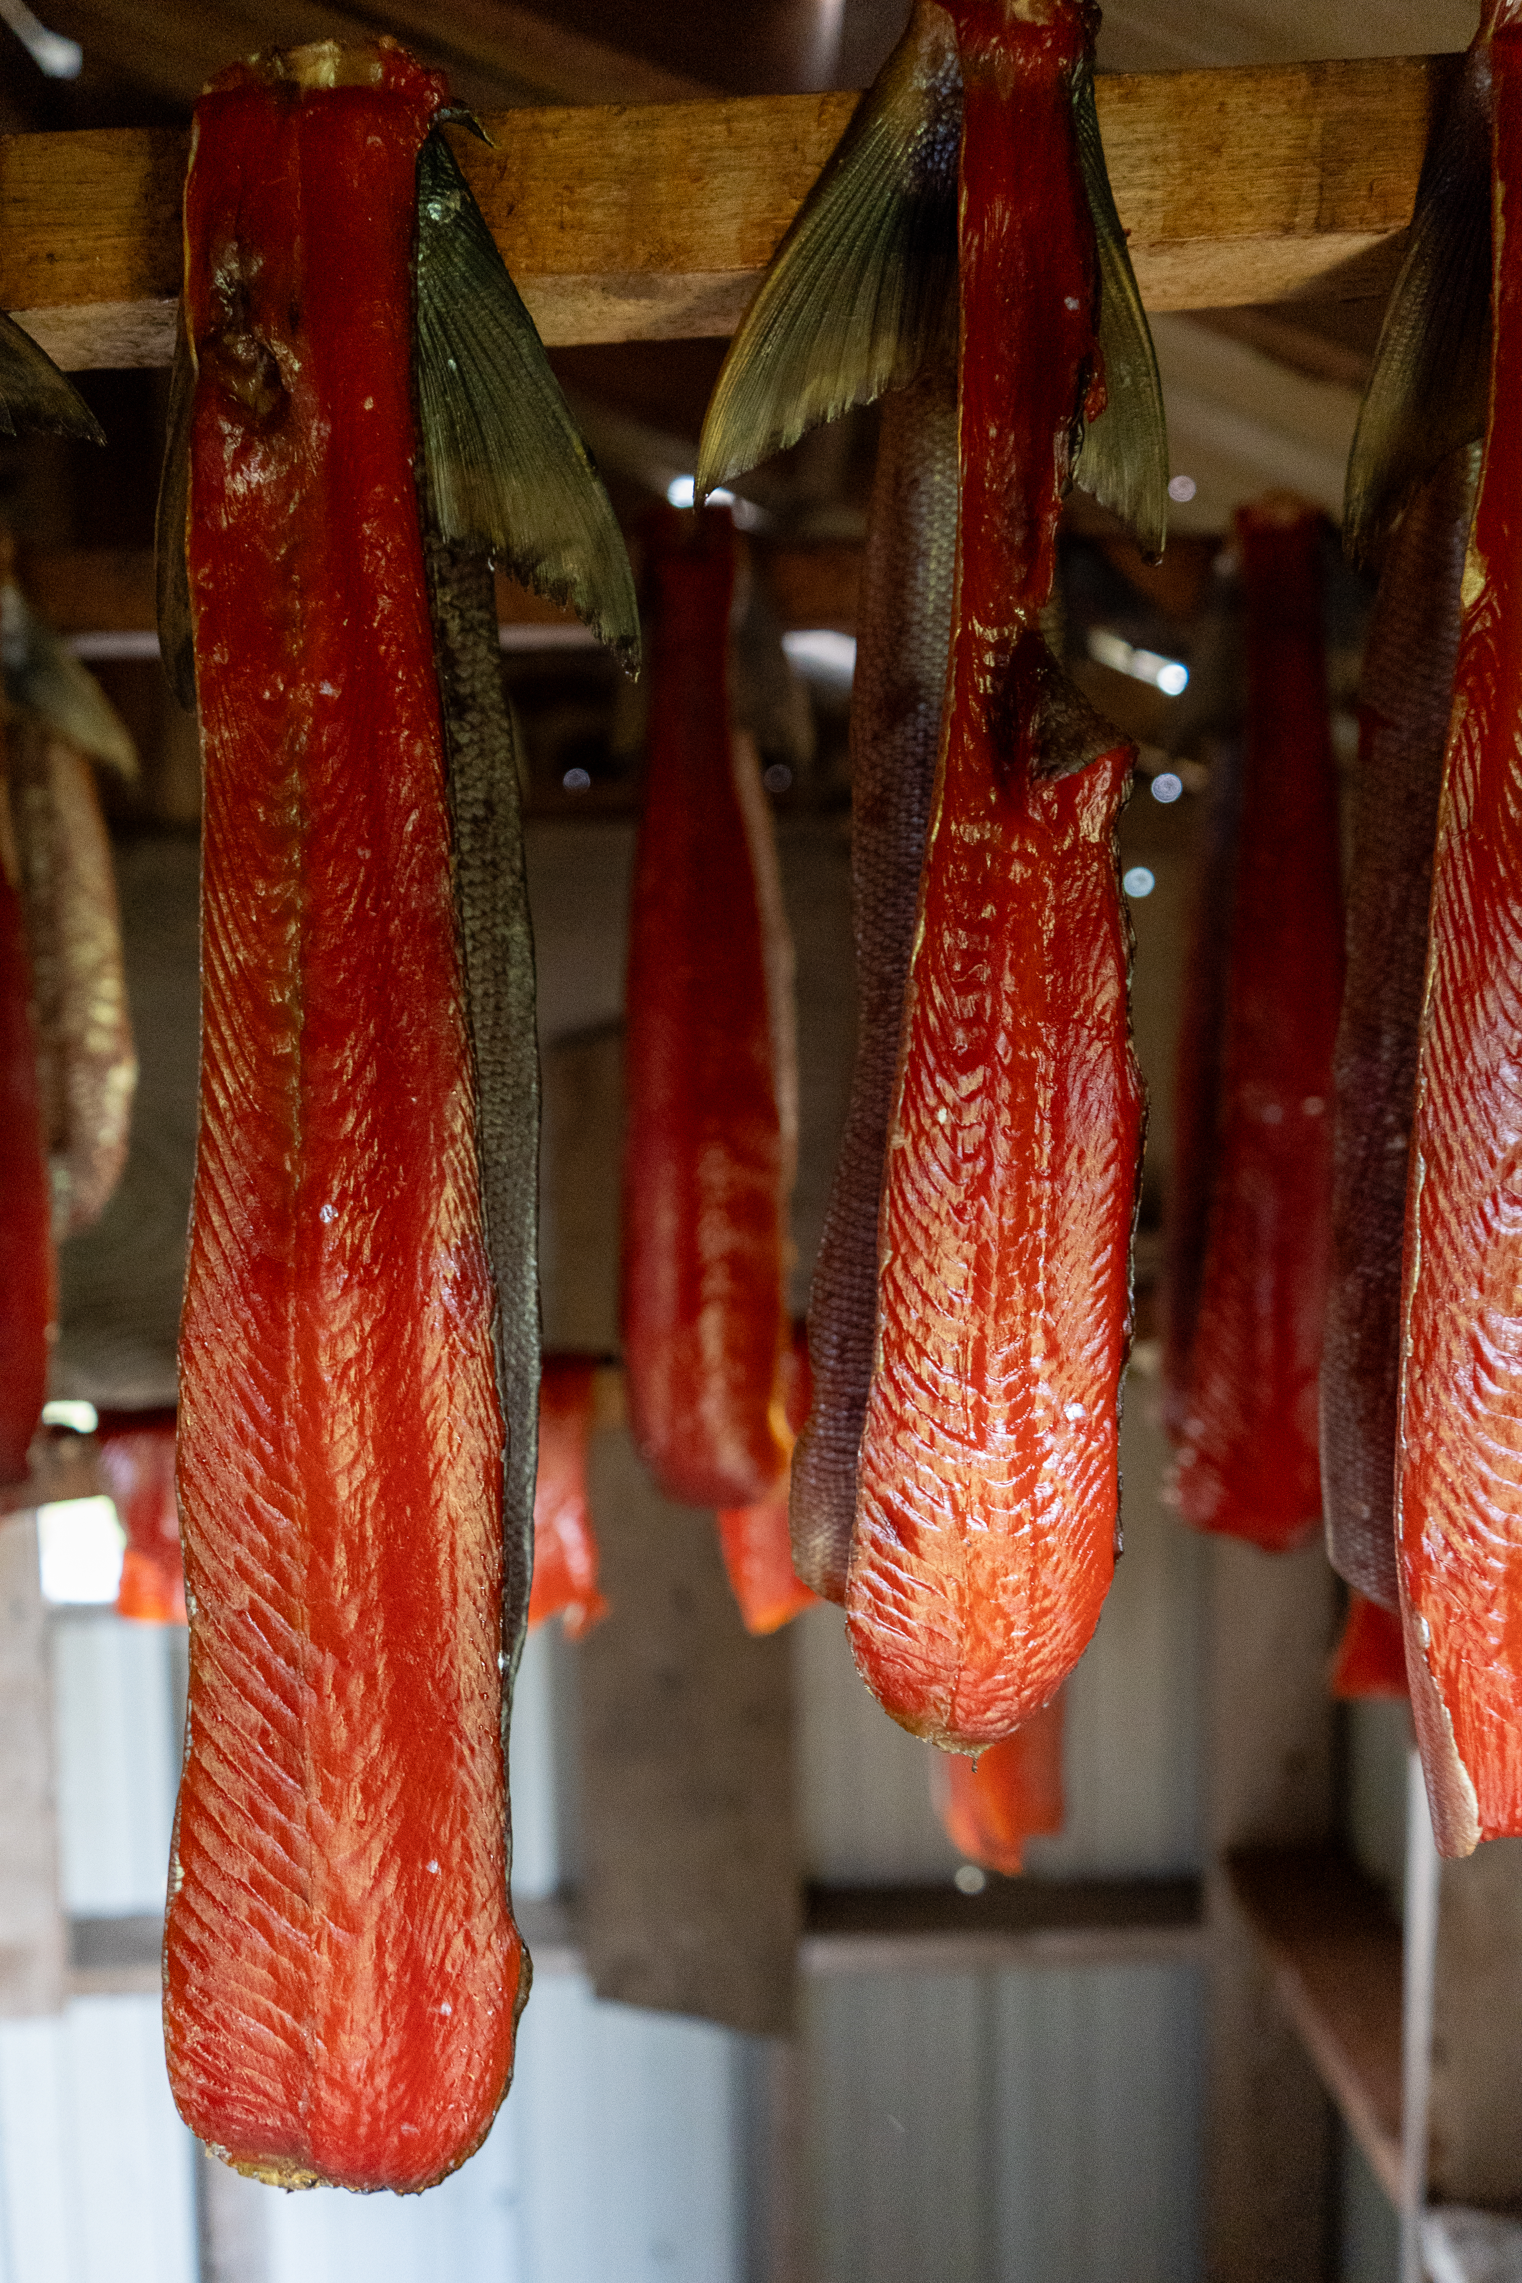
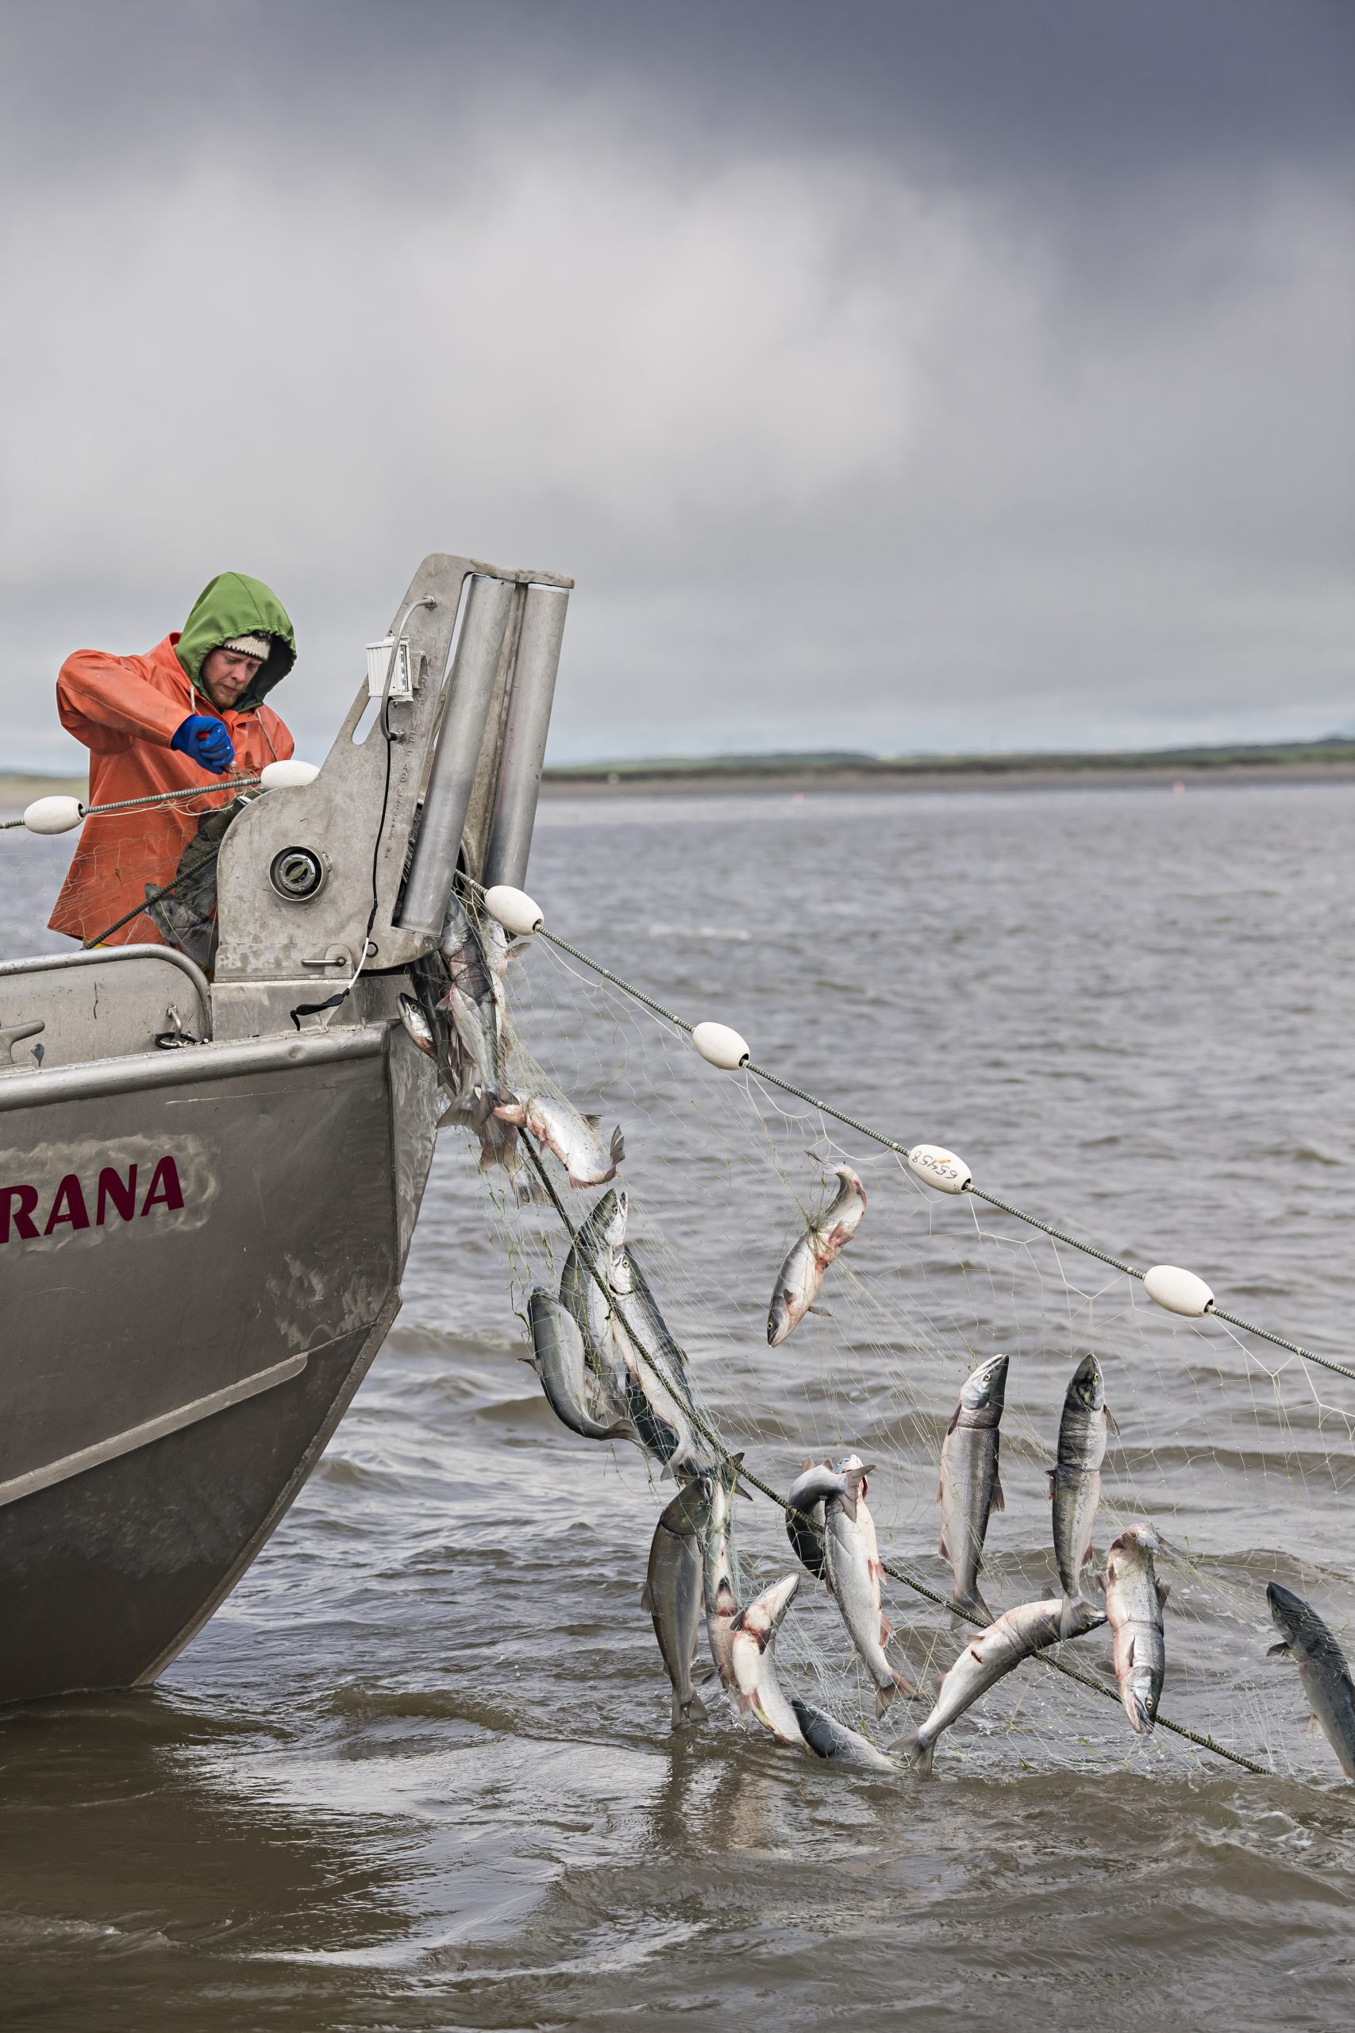
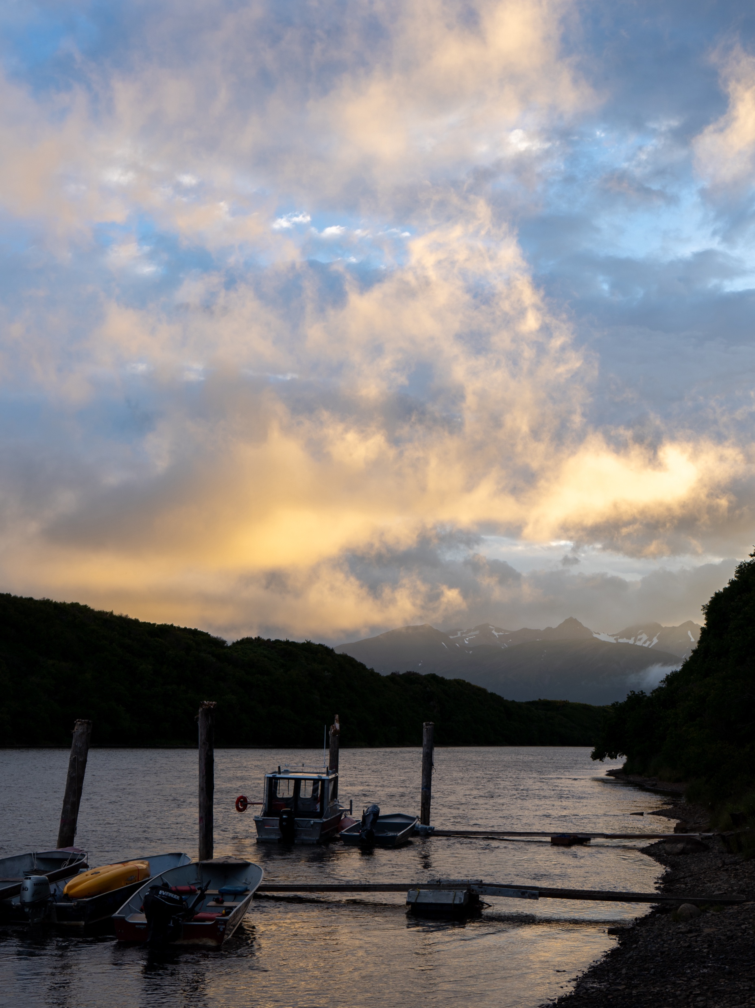
This puts managers in a bind... - Allow harvest - protect fish (rebuild stock) - Make sure this never happens again (climate adaptation and resilliance)

Slide 4
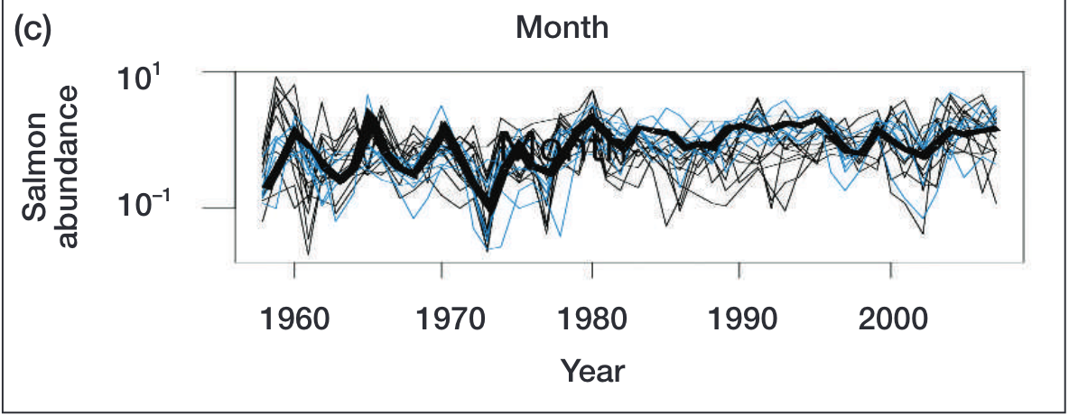
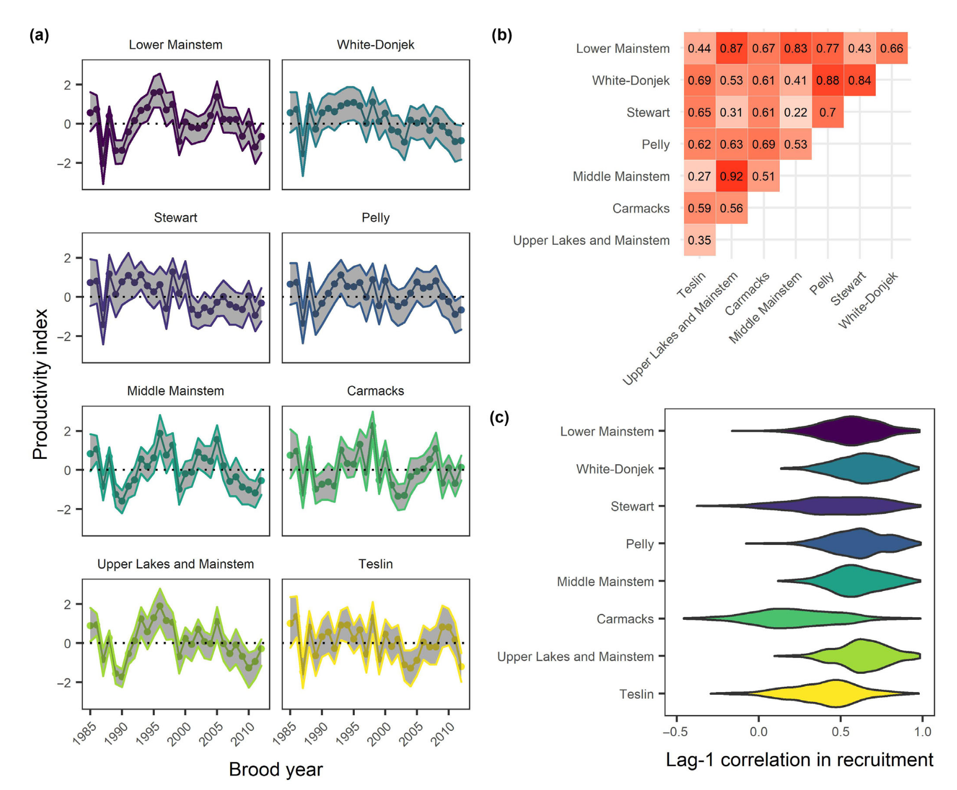
The ”Portfolio effect”
Natural variability (within and among systems, species, etc) “diversifies” assets similar to financial markets, dampens variation for the population
Weak or negative covariance among salmon metapopulation timing/production over space/time contributes towards population stability/resilliance to climate change

Slide 5
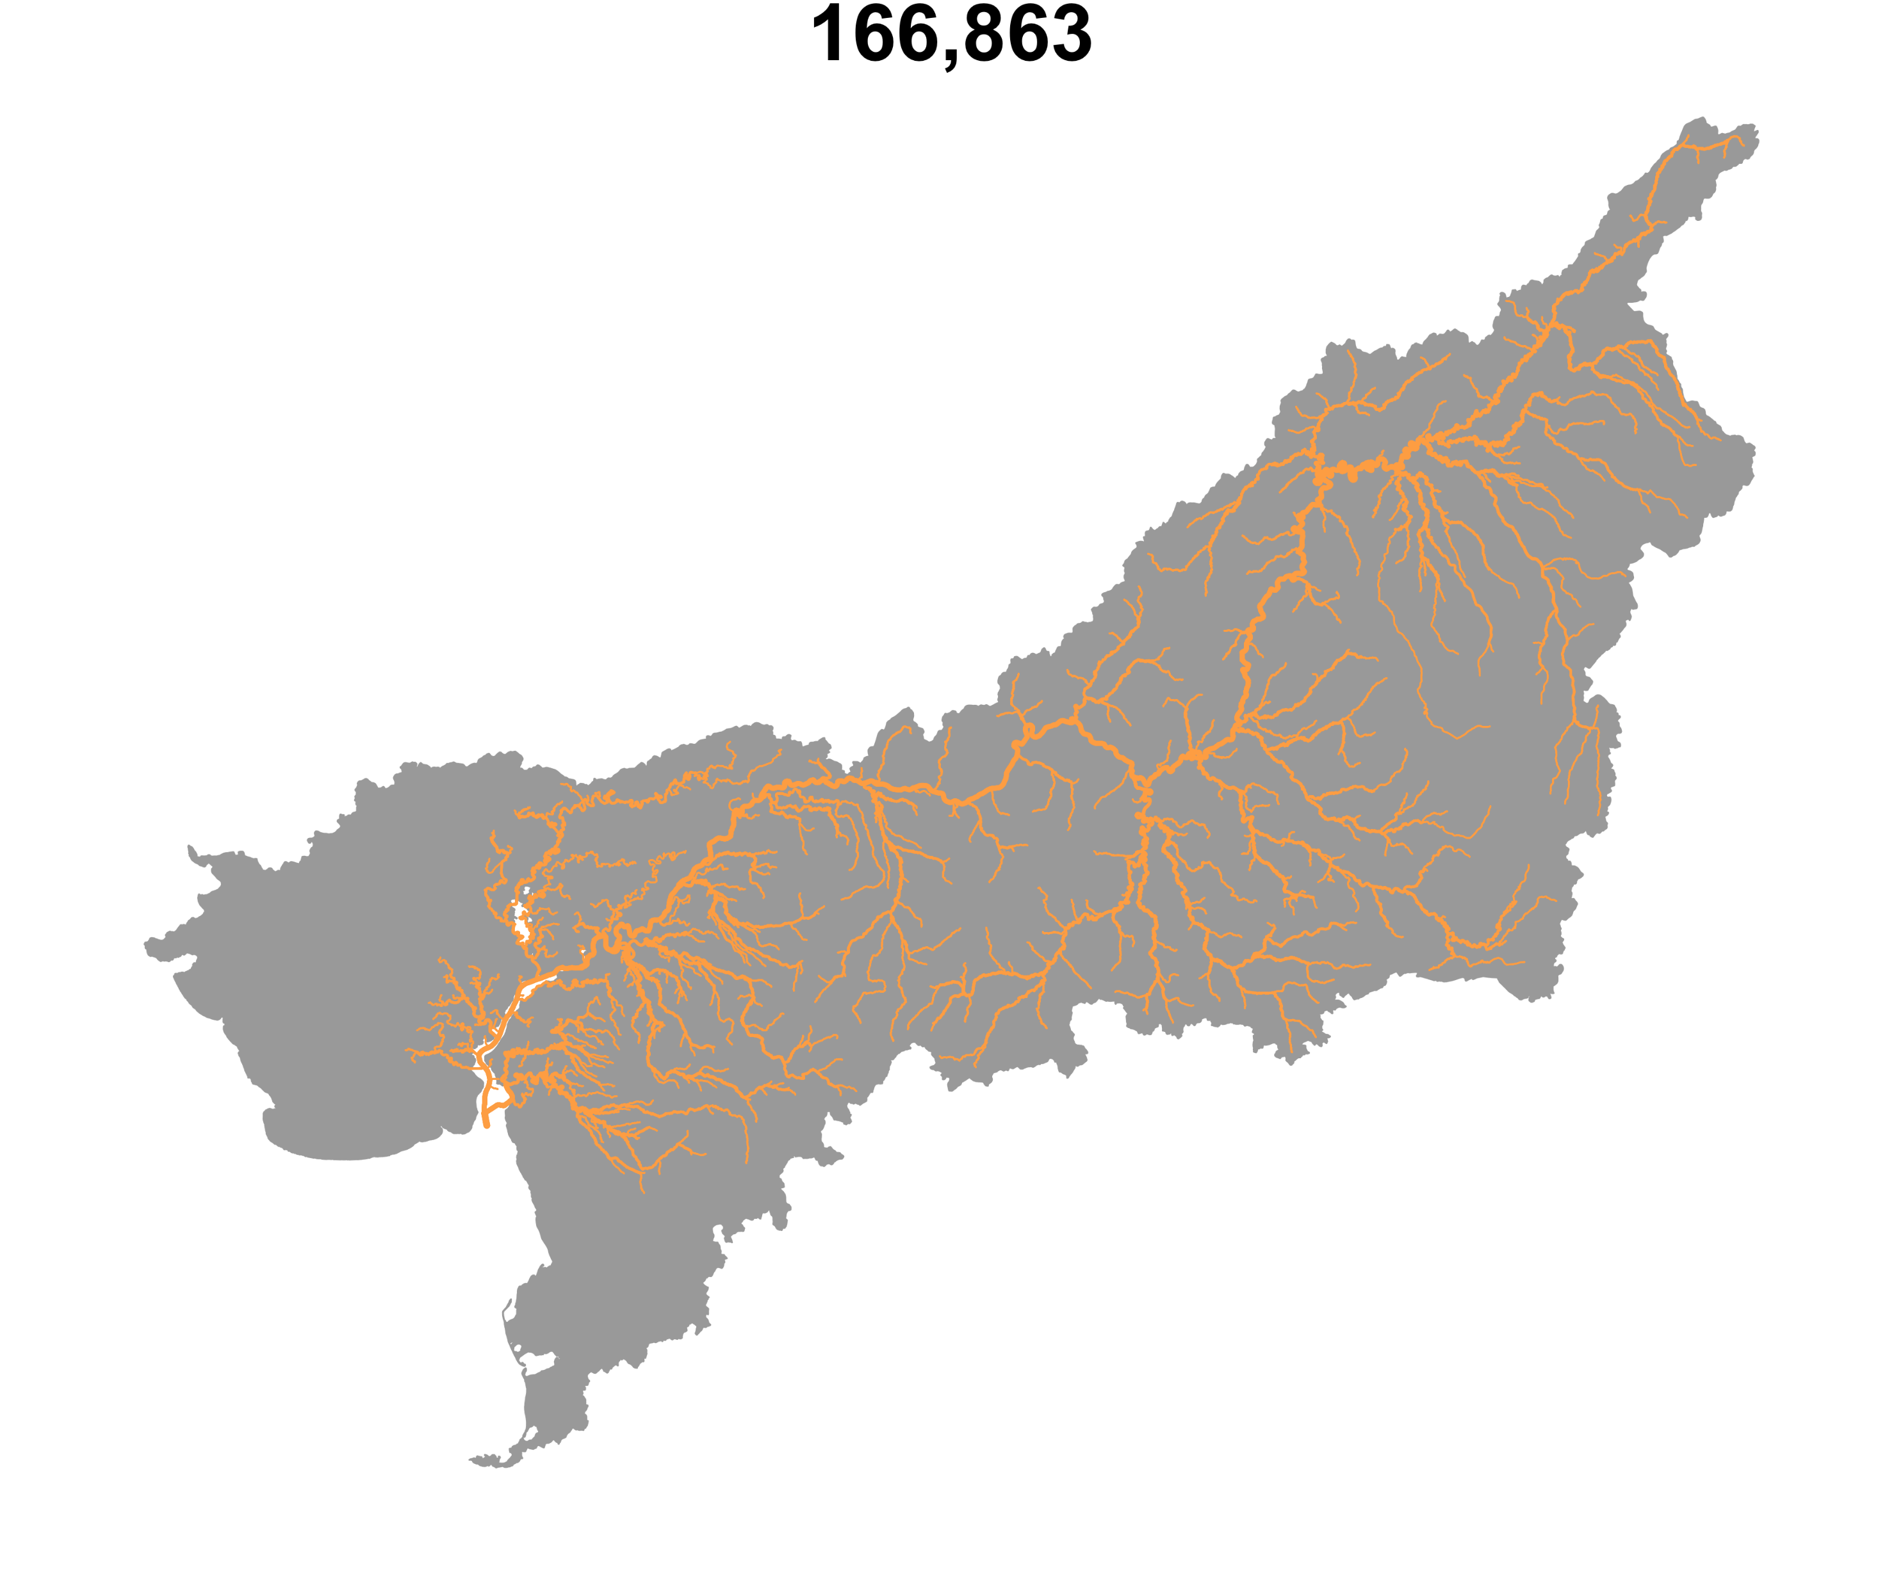

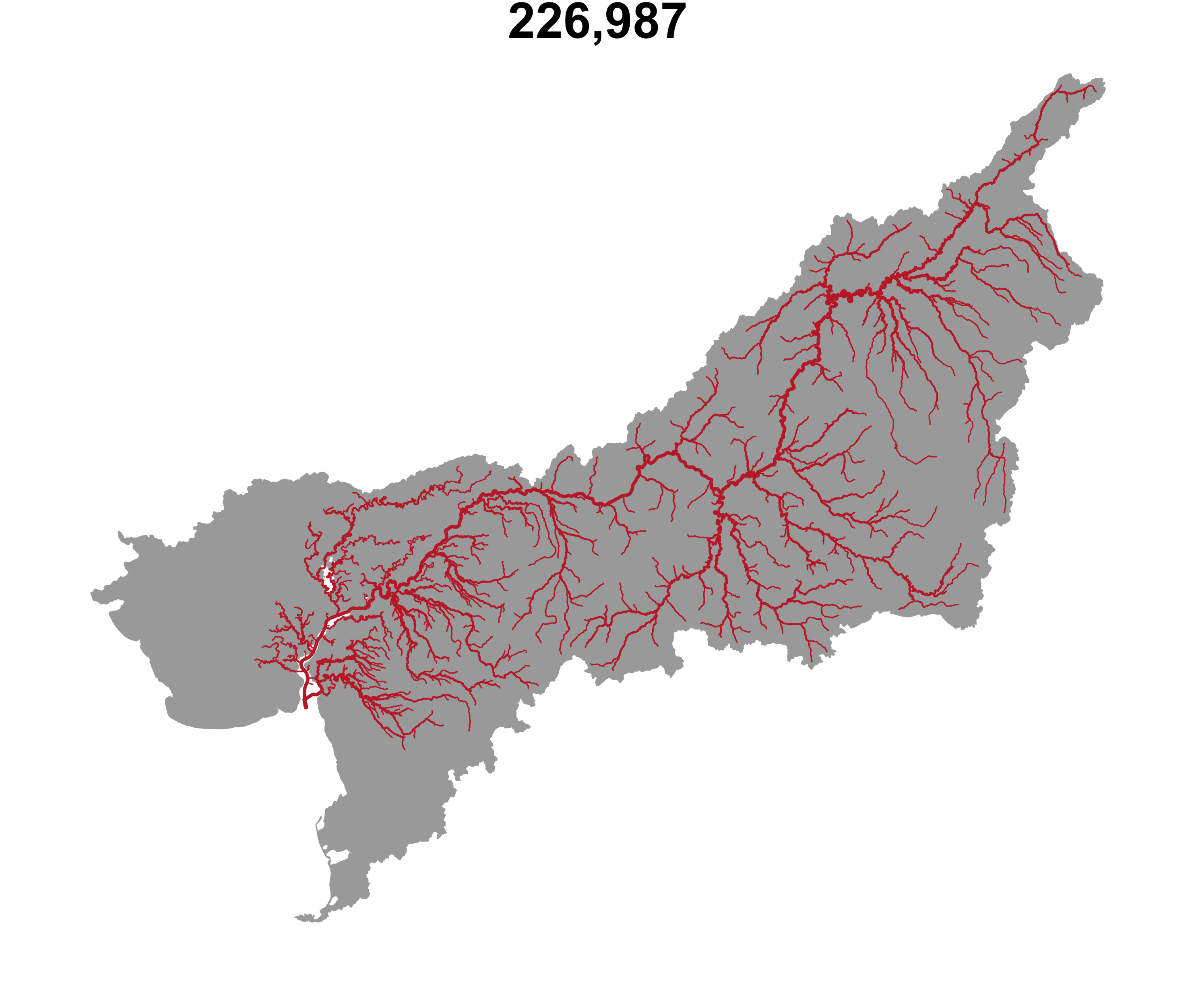
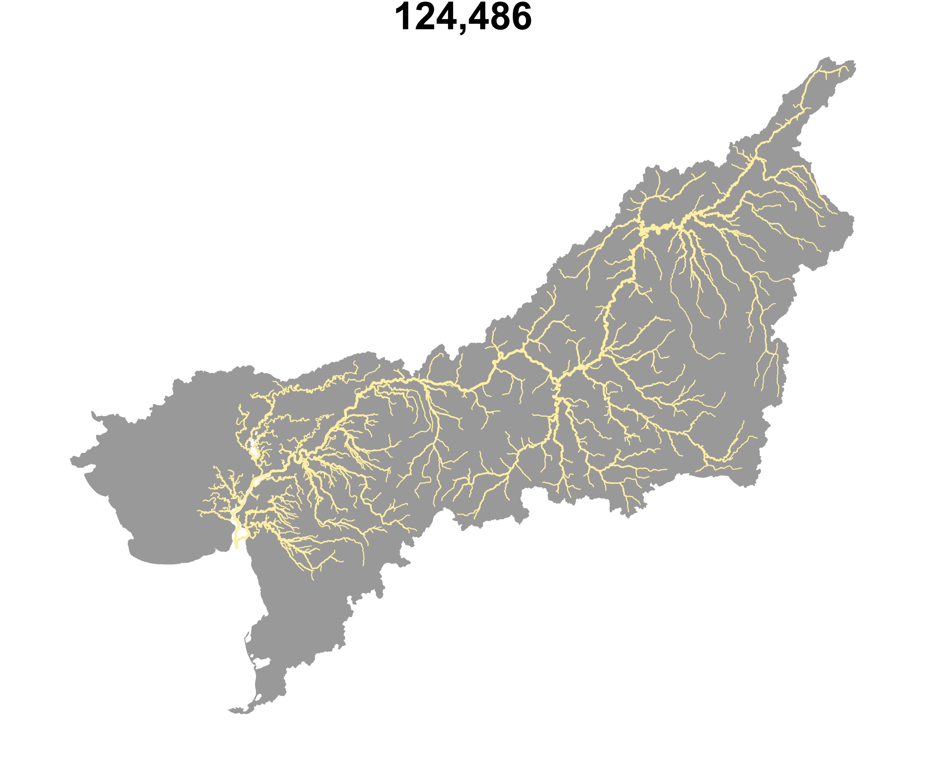

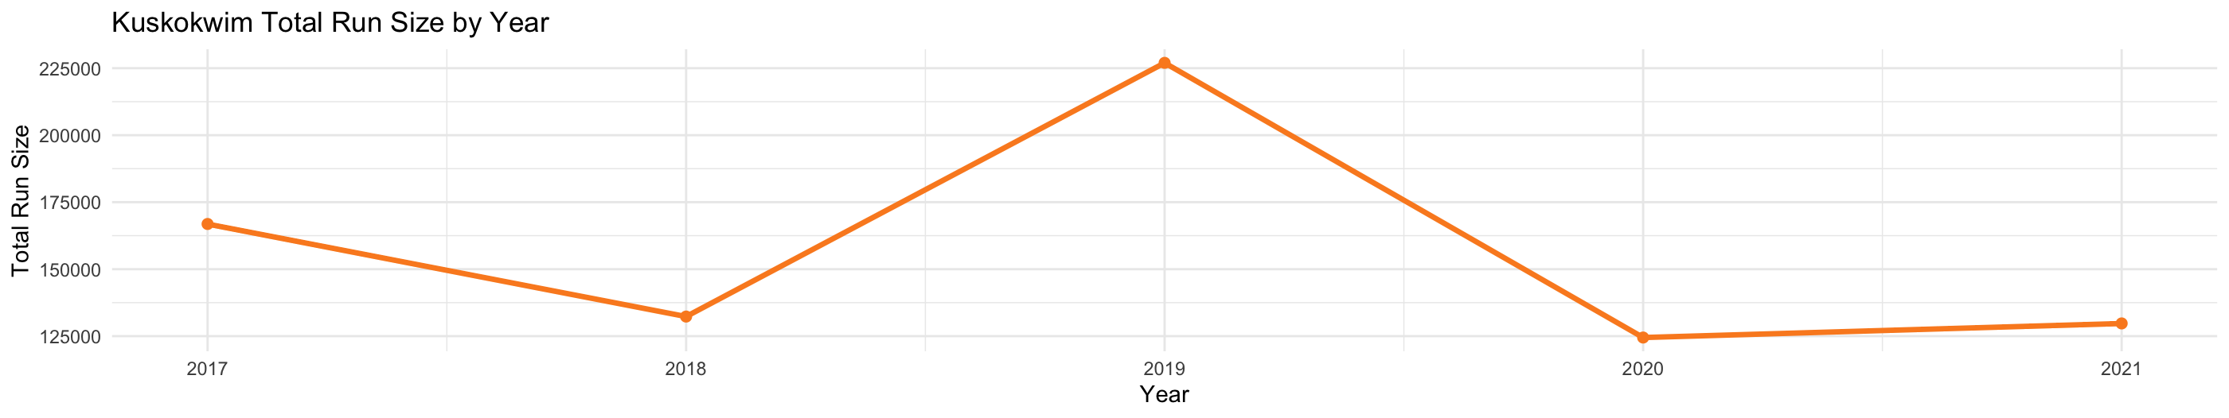
Assessing ecosystem health needs to incorporate the health of each component, not overall abundance

Slide 6

Currently: very little understanding of spatial distribution/timing in the Kuskokwim

Slide 7
The remedy; front end closures until June 11th (~ 10 days into the season).
Boosts overall numbers, but what stock(s) does it protect?

Slide 8
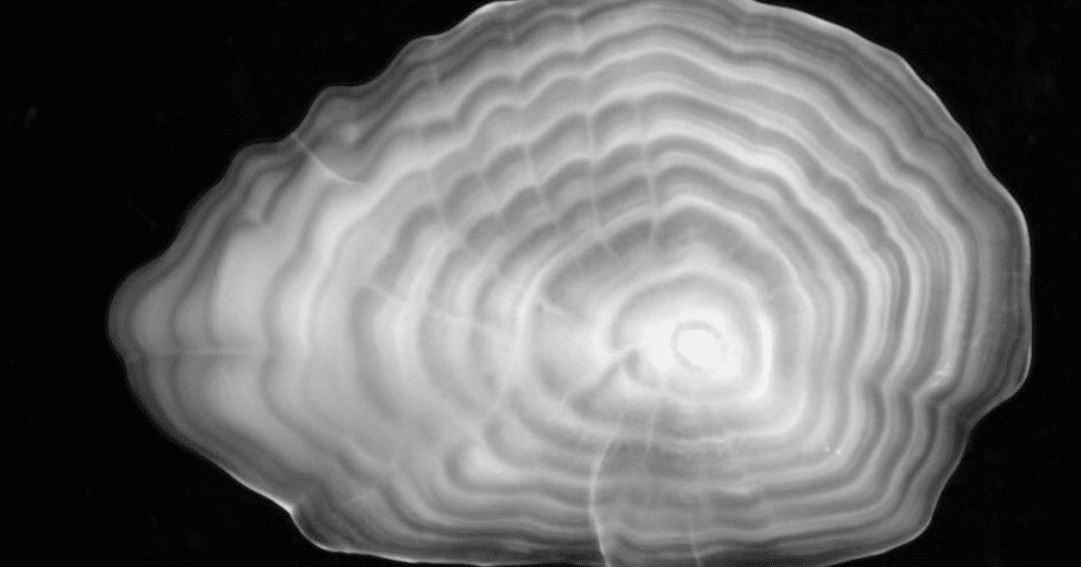
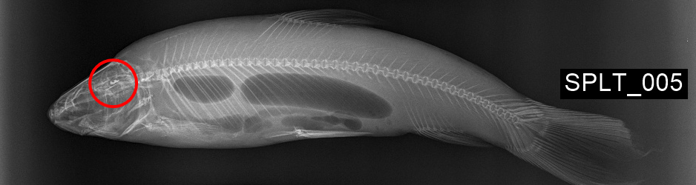
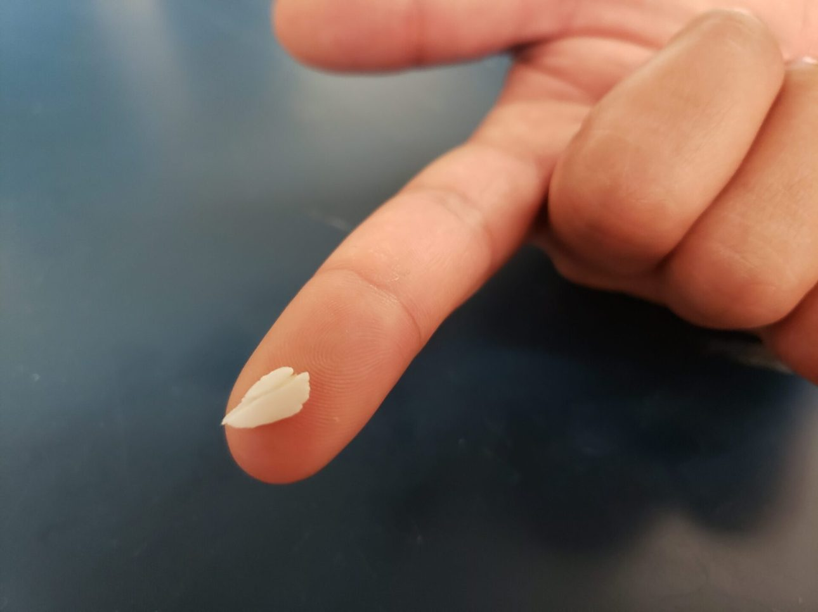
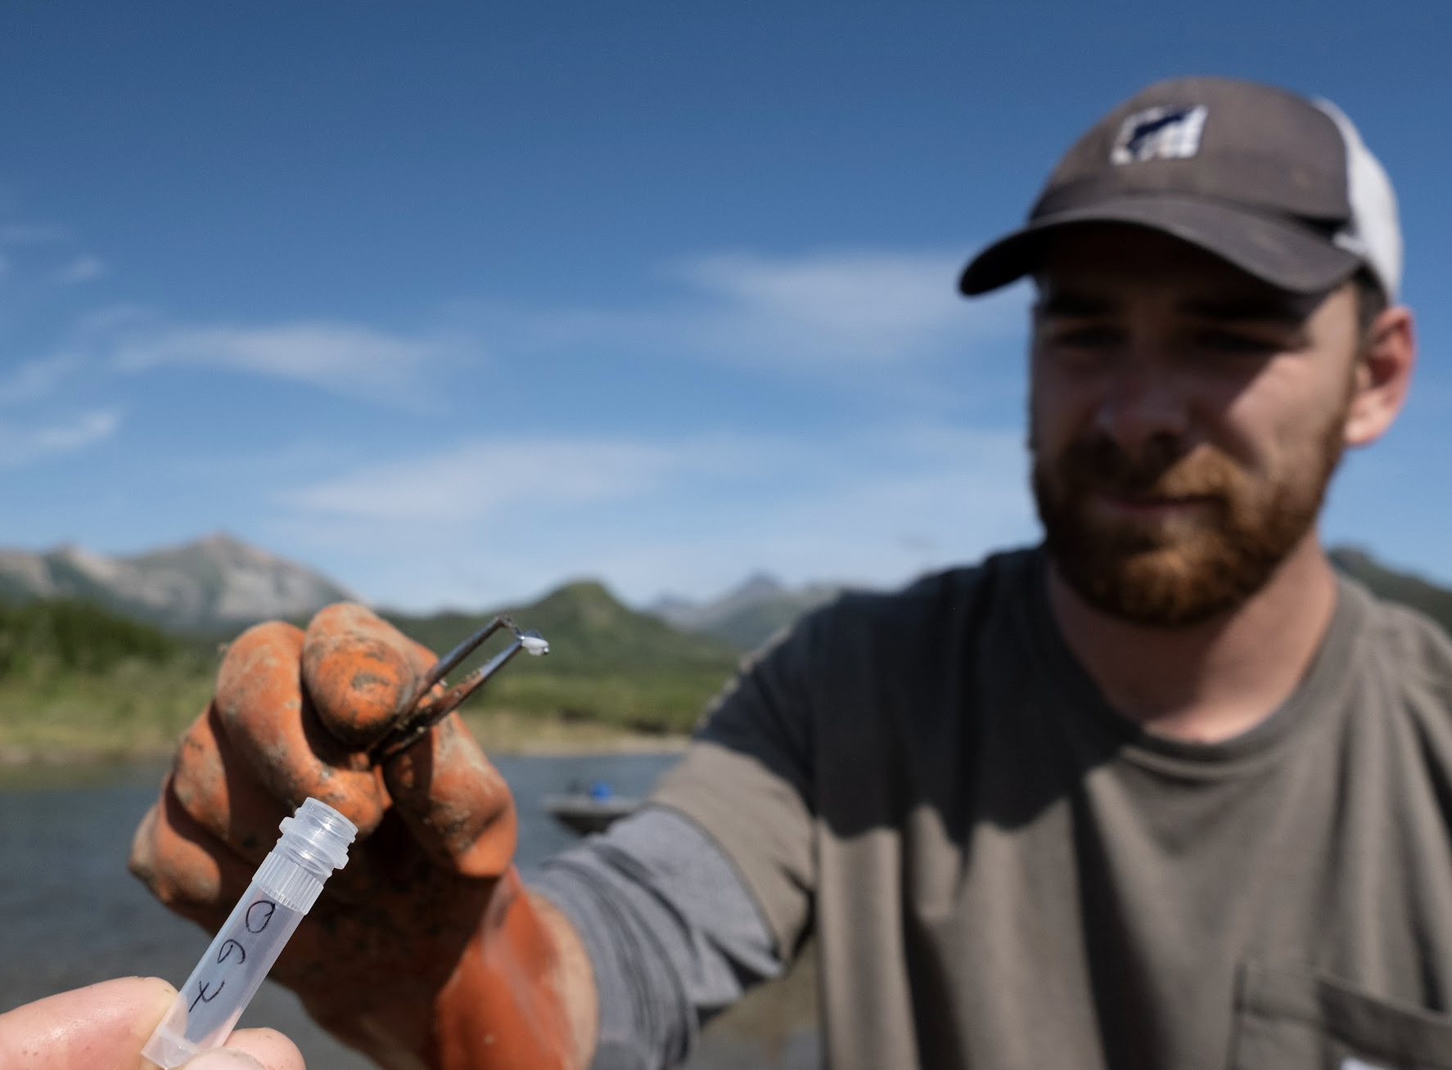
Otoliths
; a “time capsule”
Notes:
... so we use otoliths...

Slide 9
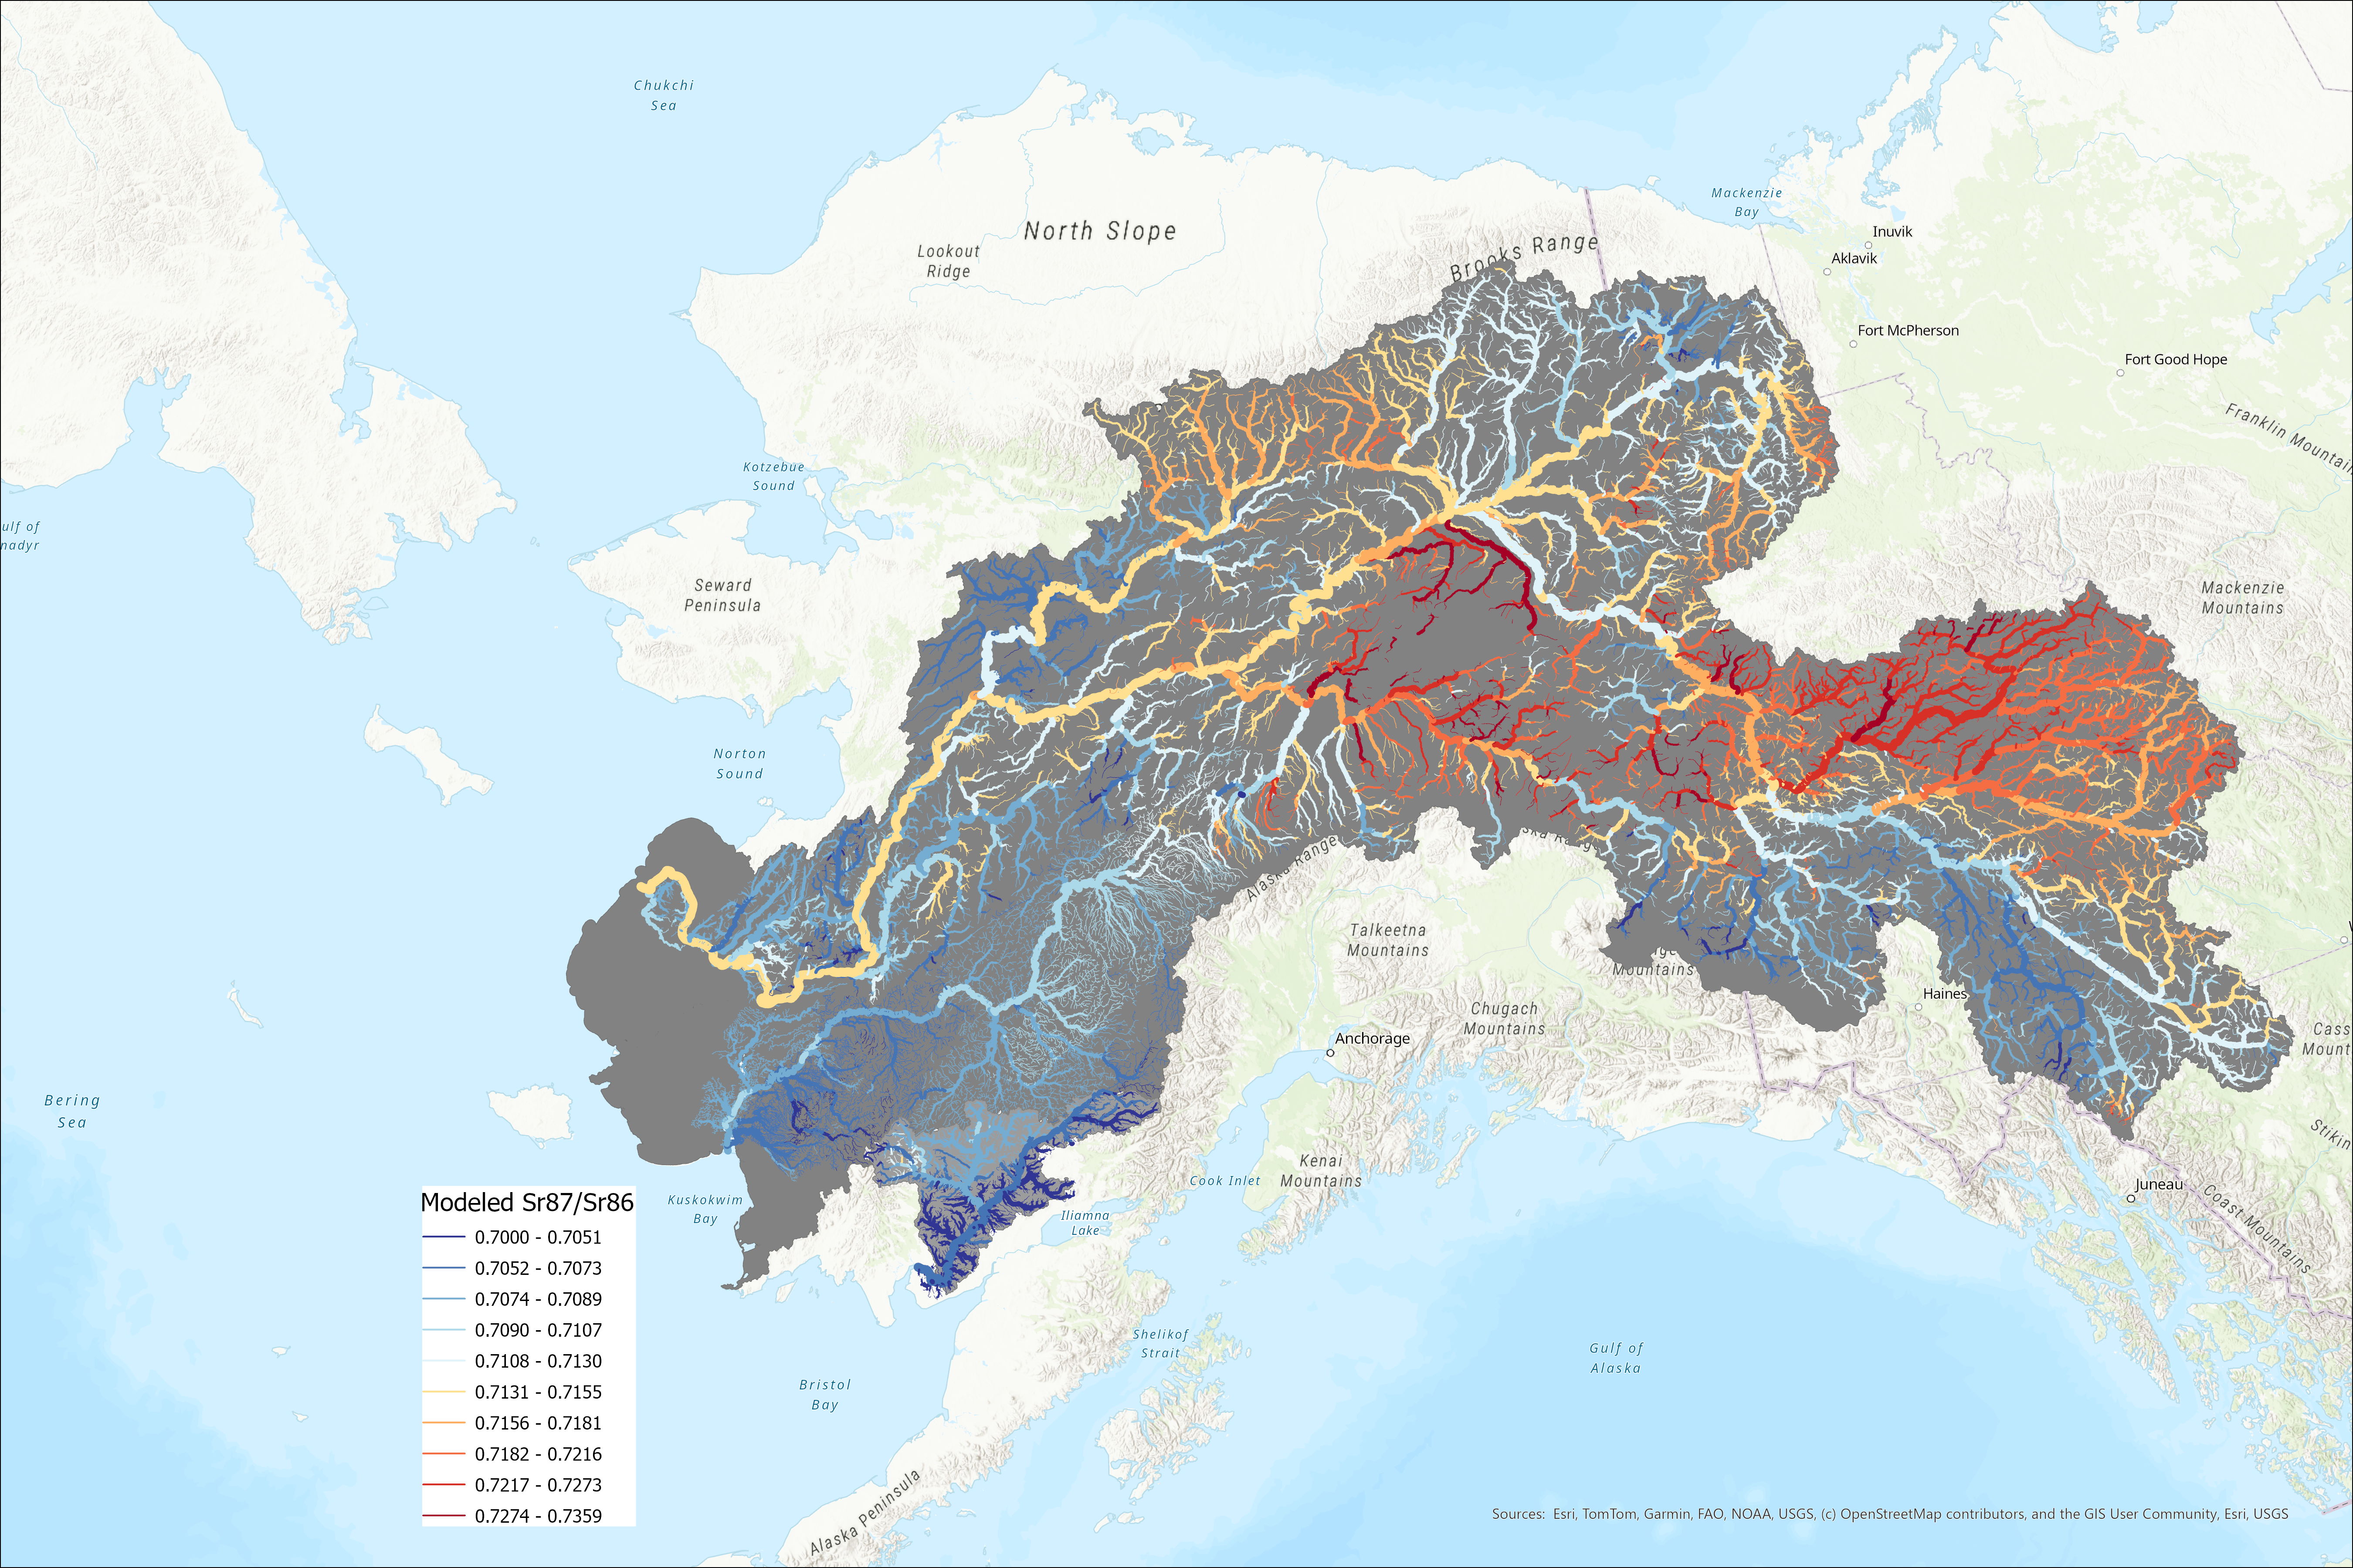
Strontium
Sr⁸⁷/Sr⁸⁶
Notes:
Precise estimate

Slide 10

5 years of otolith samples,
Currently almost no understanding of spatial distribution/timing in the Kuskokwim
Kuskokwim

Slide 11
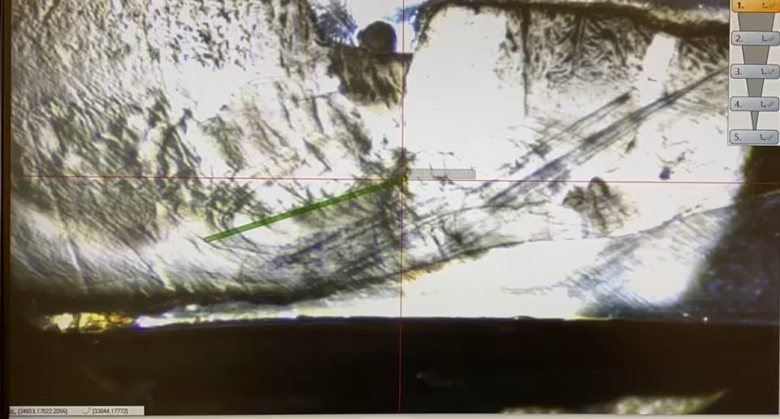
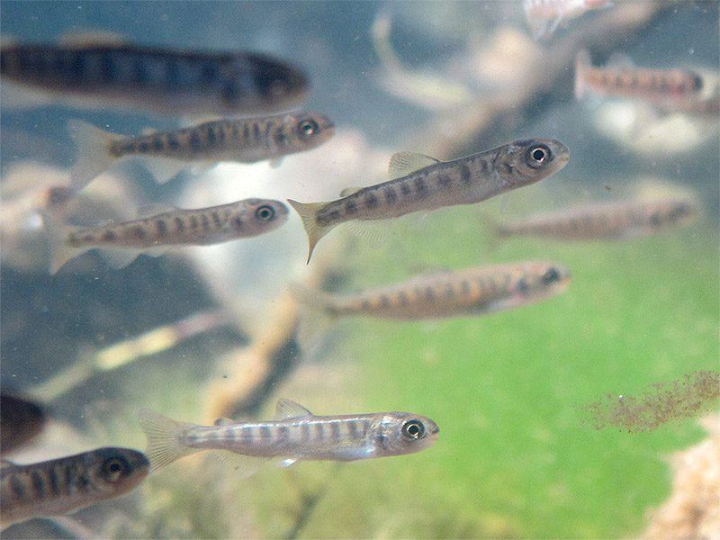
Notes:
Stress why people USUALLY look at just one

Slide 12
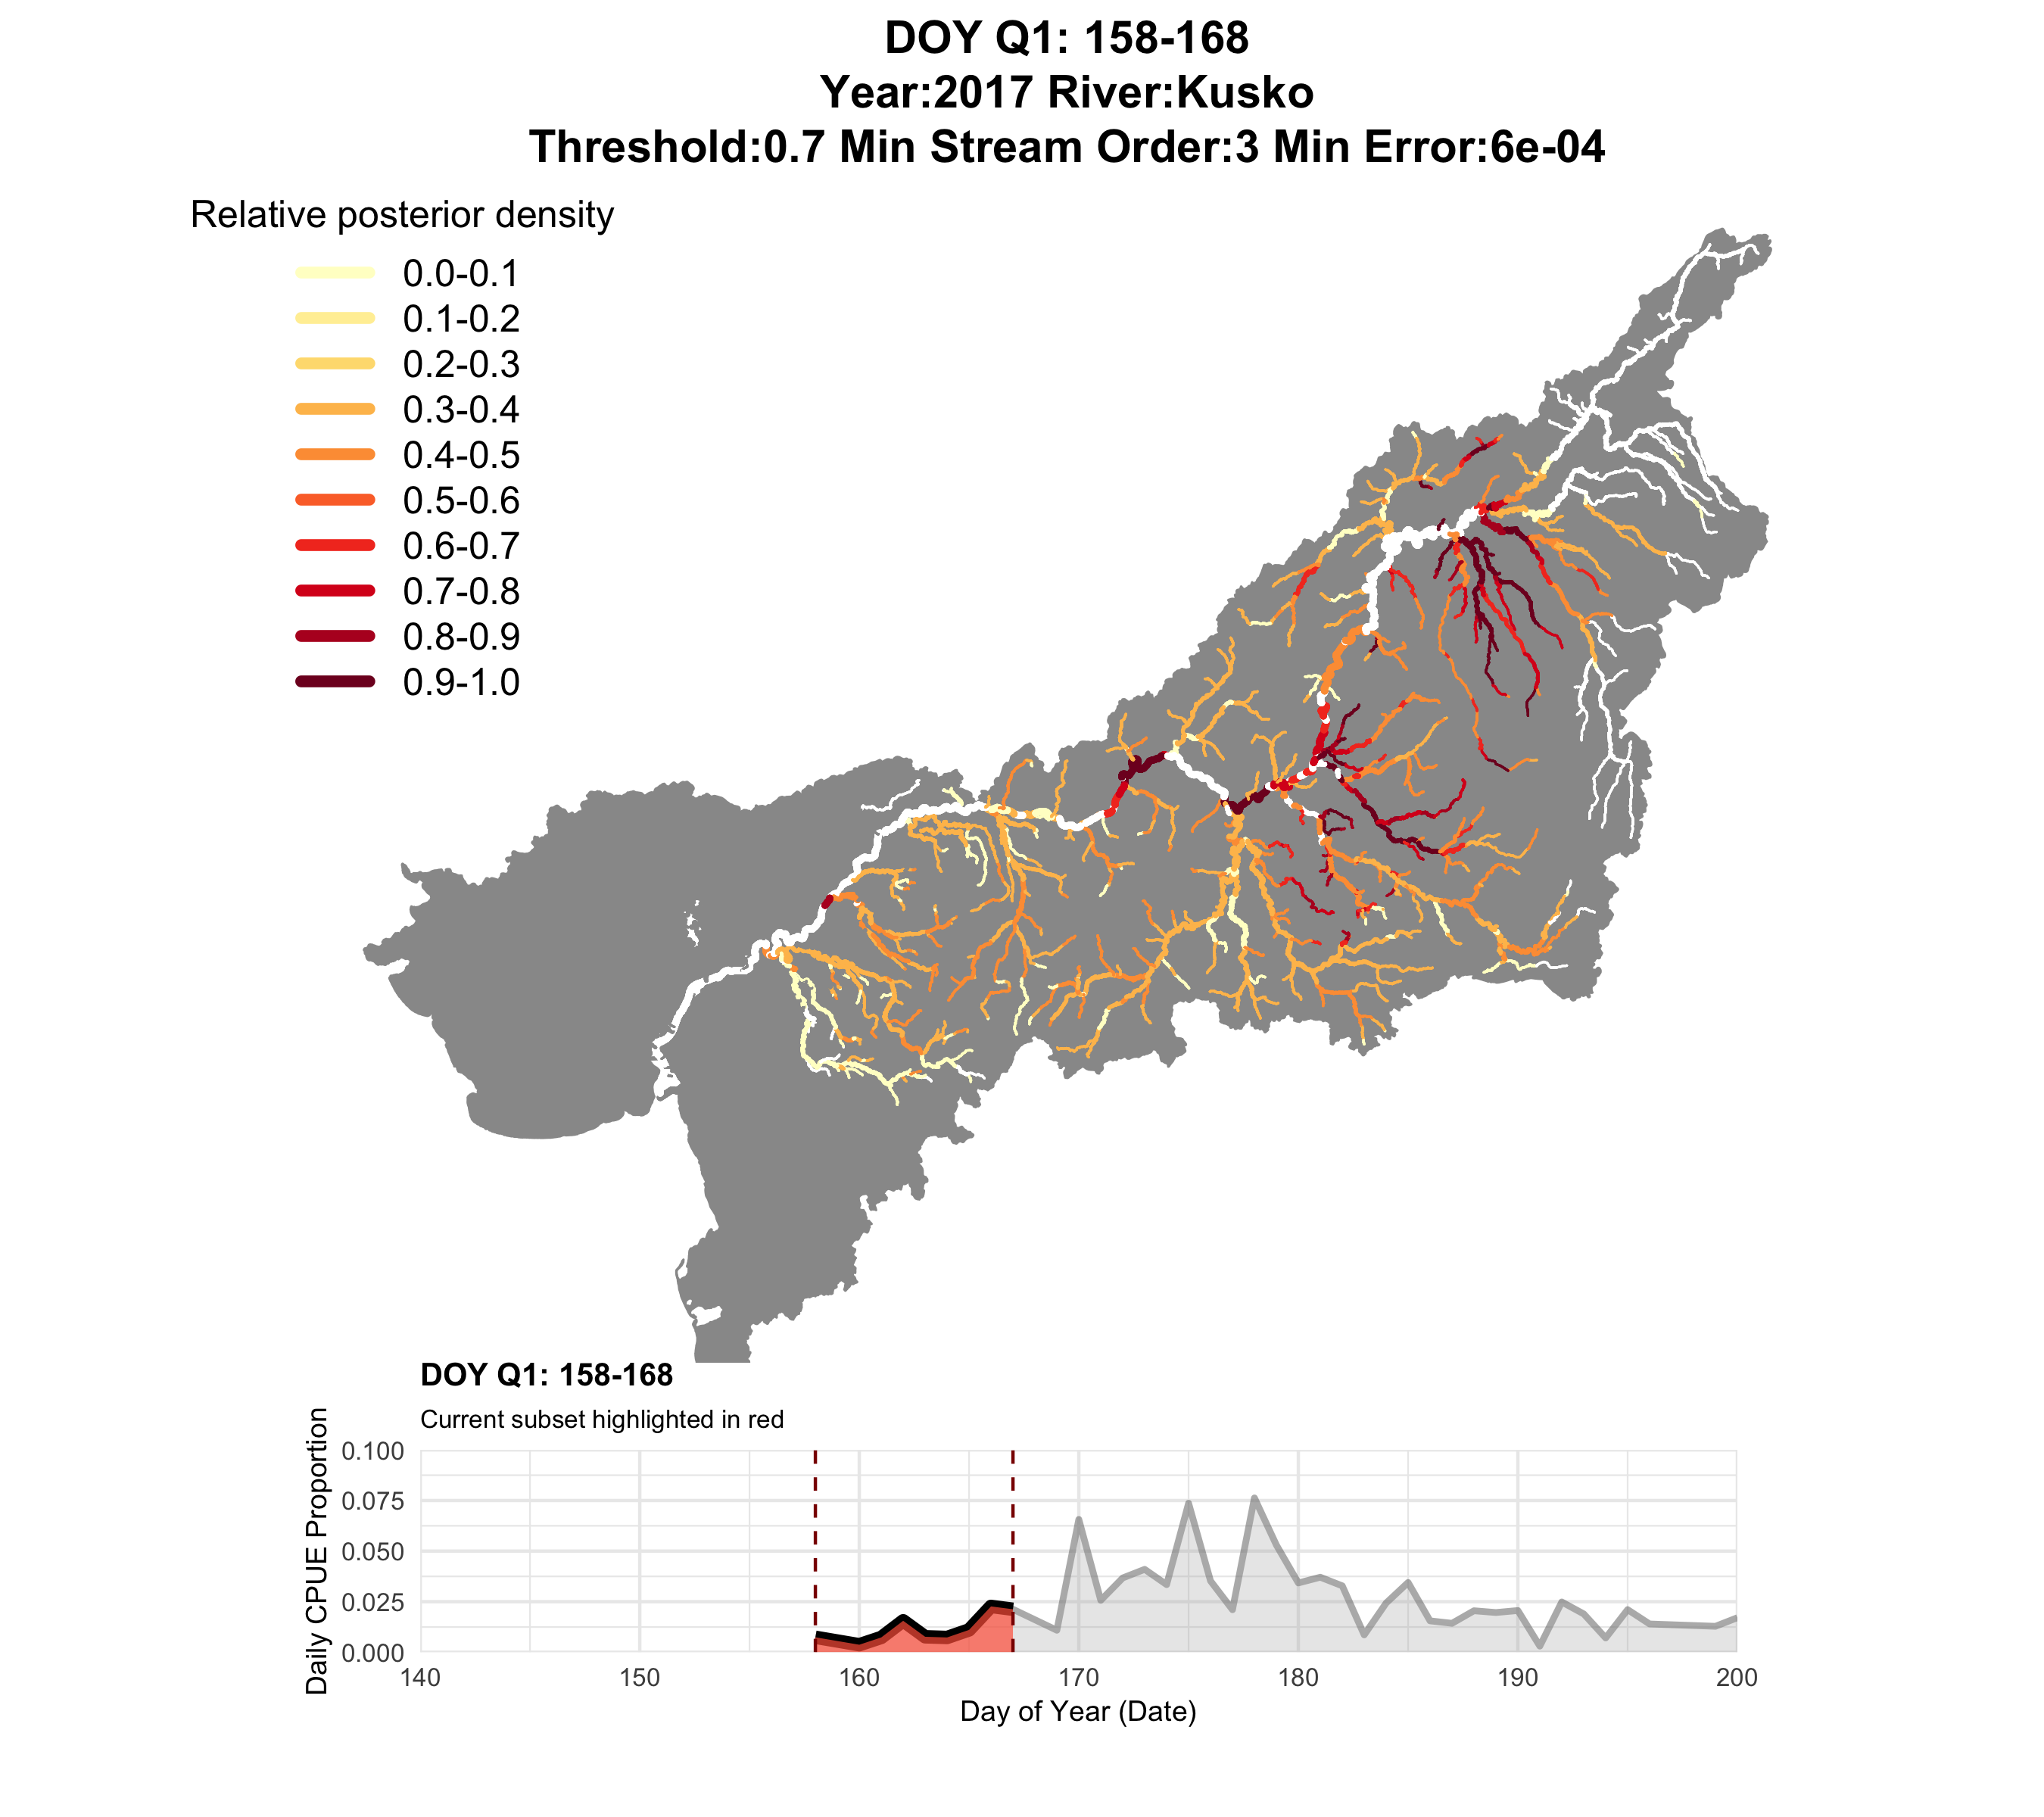
2017
Q1 (closure window)

Slide 13
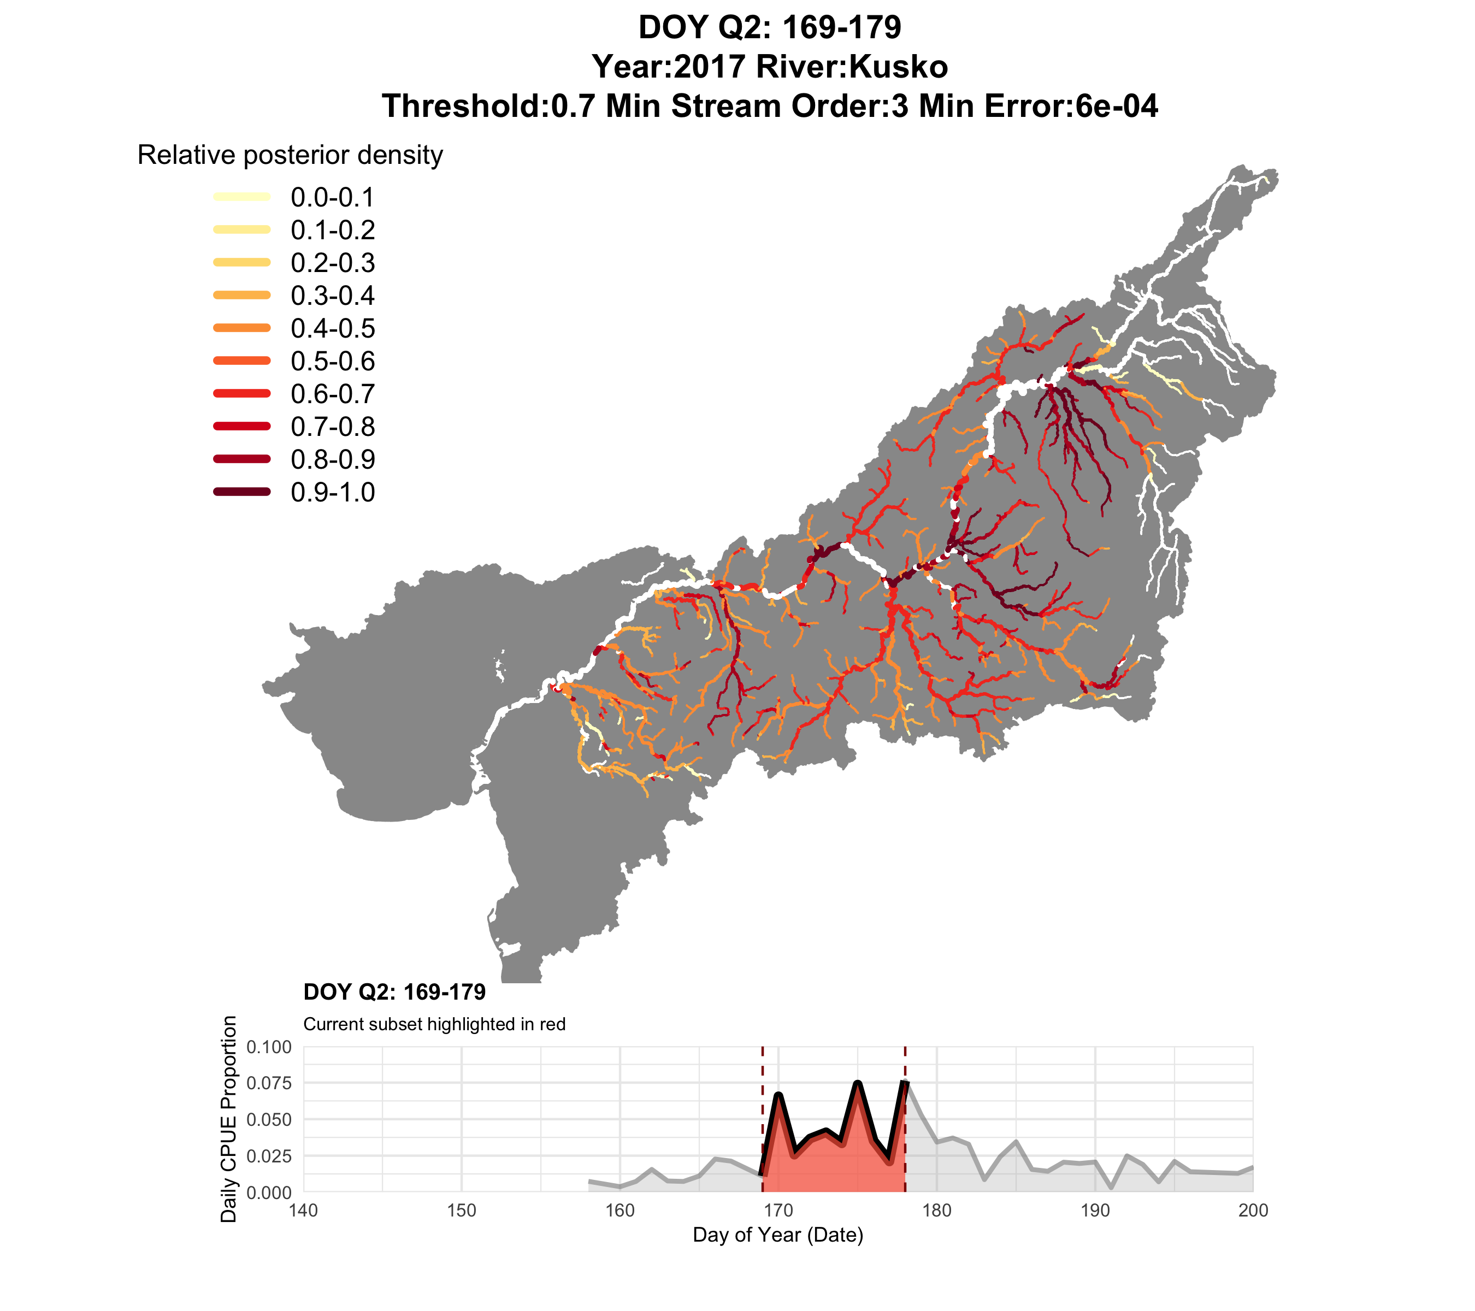
2017
Q2

Slide 14
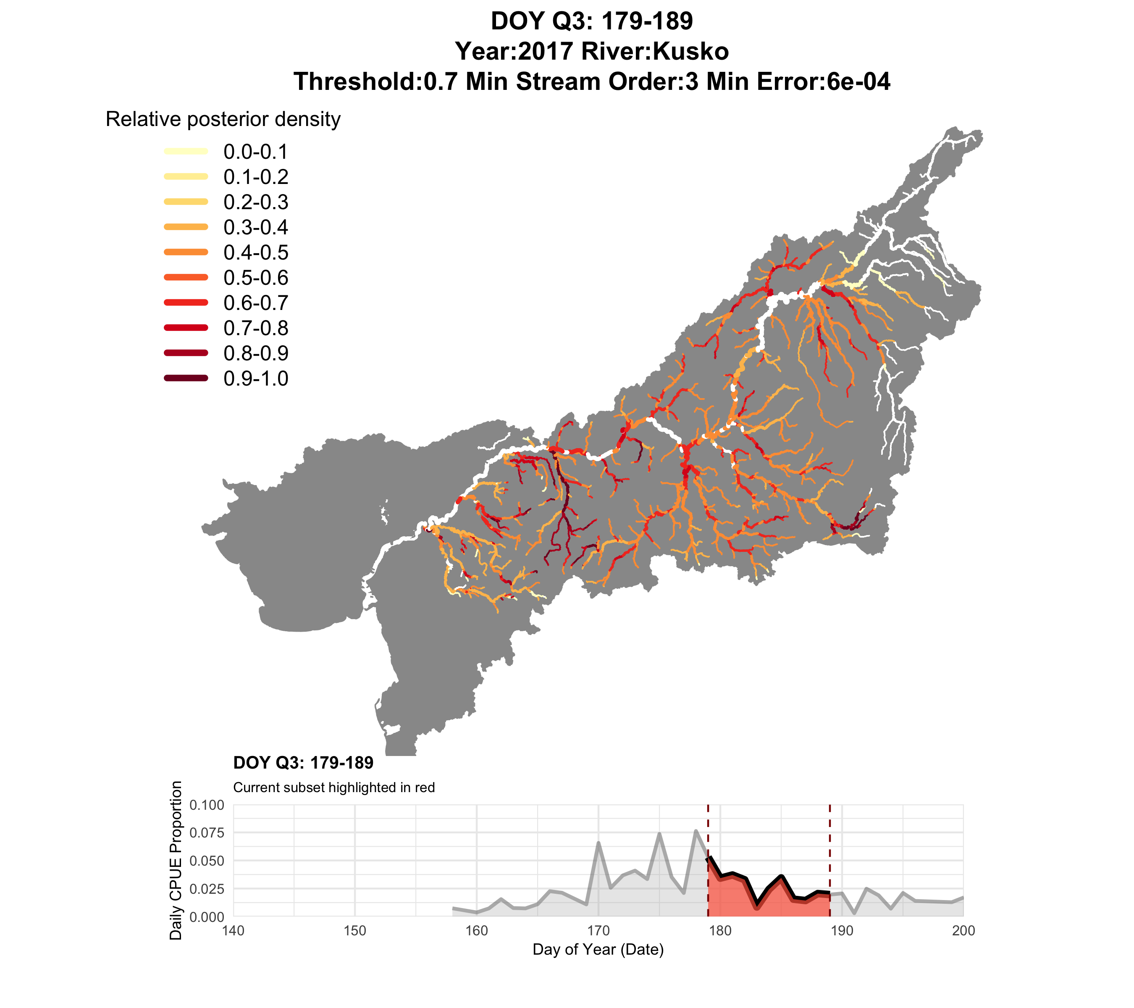
2017
Q3

Slide 15
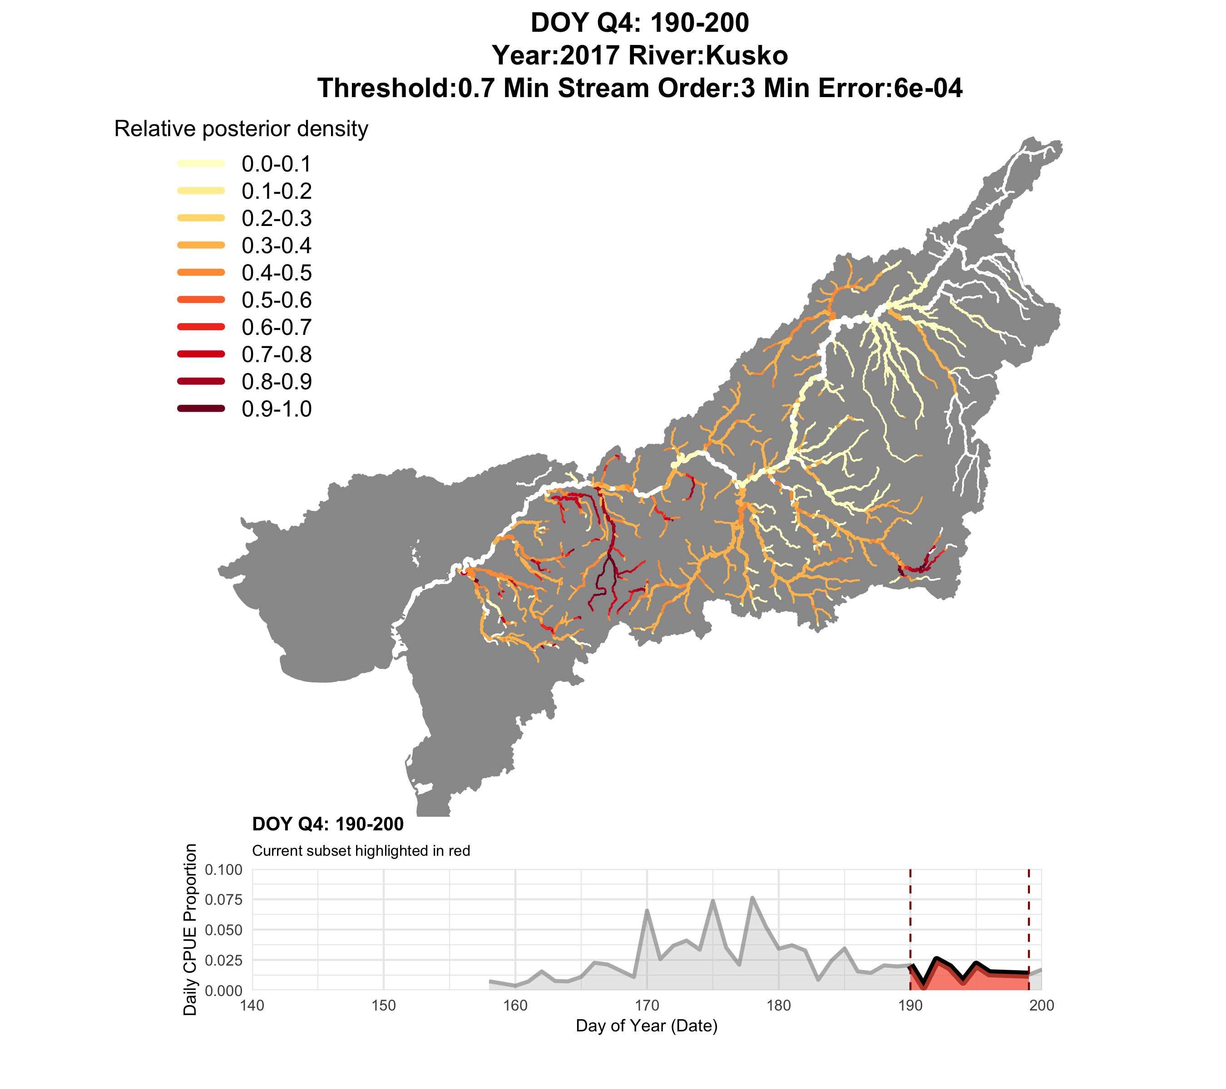
2017
Q4

Slide 16

2018
Q1 (closure window)

Slide 17
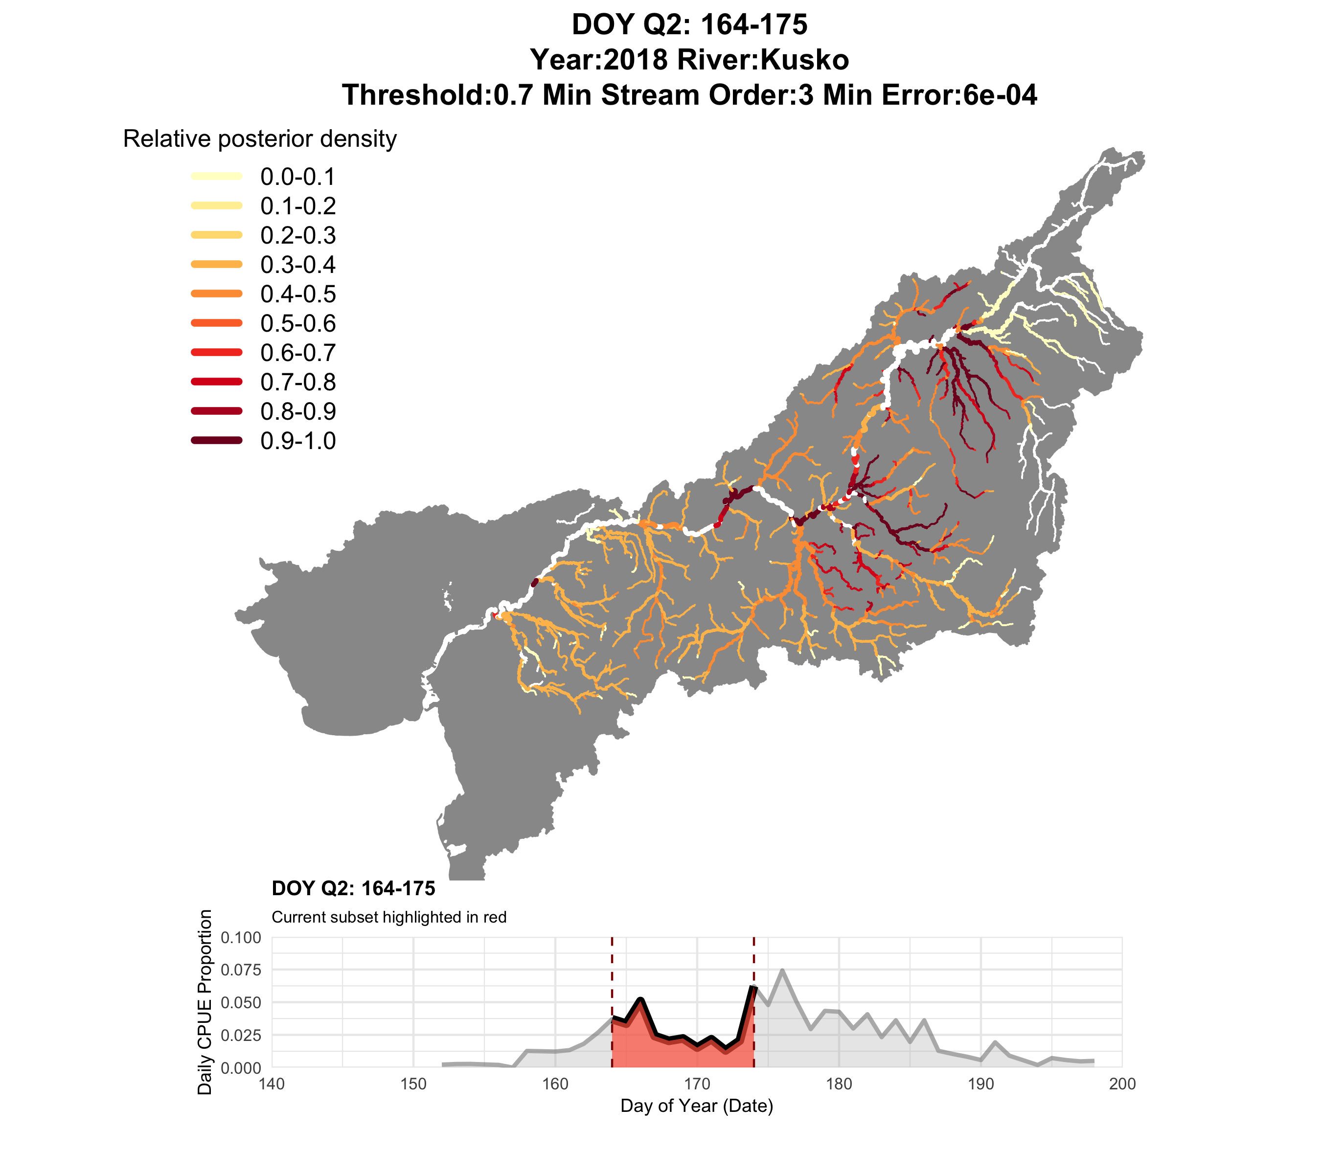
2018
Q2

Slide 18
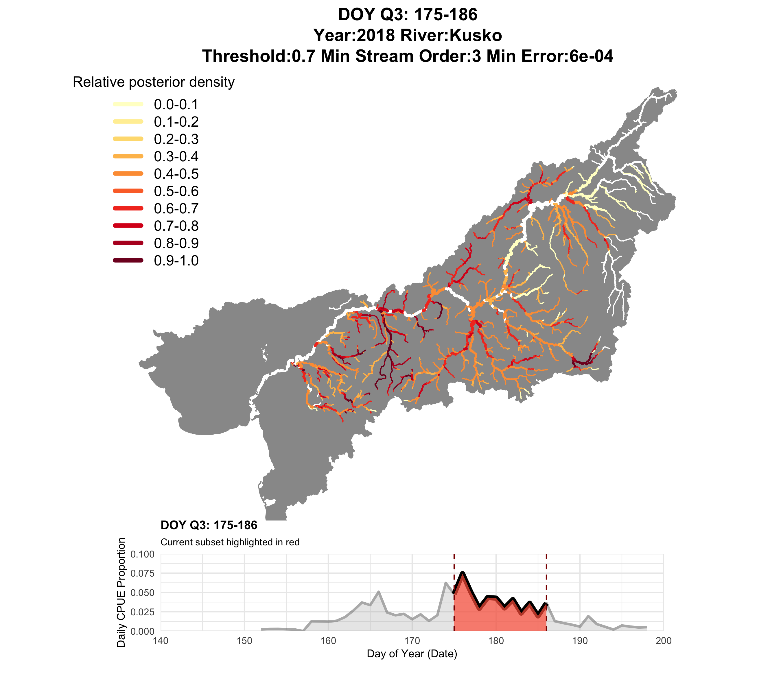
2018
Q3

Slide 19
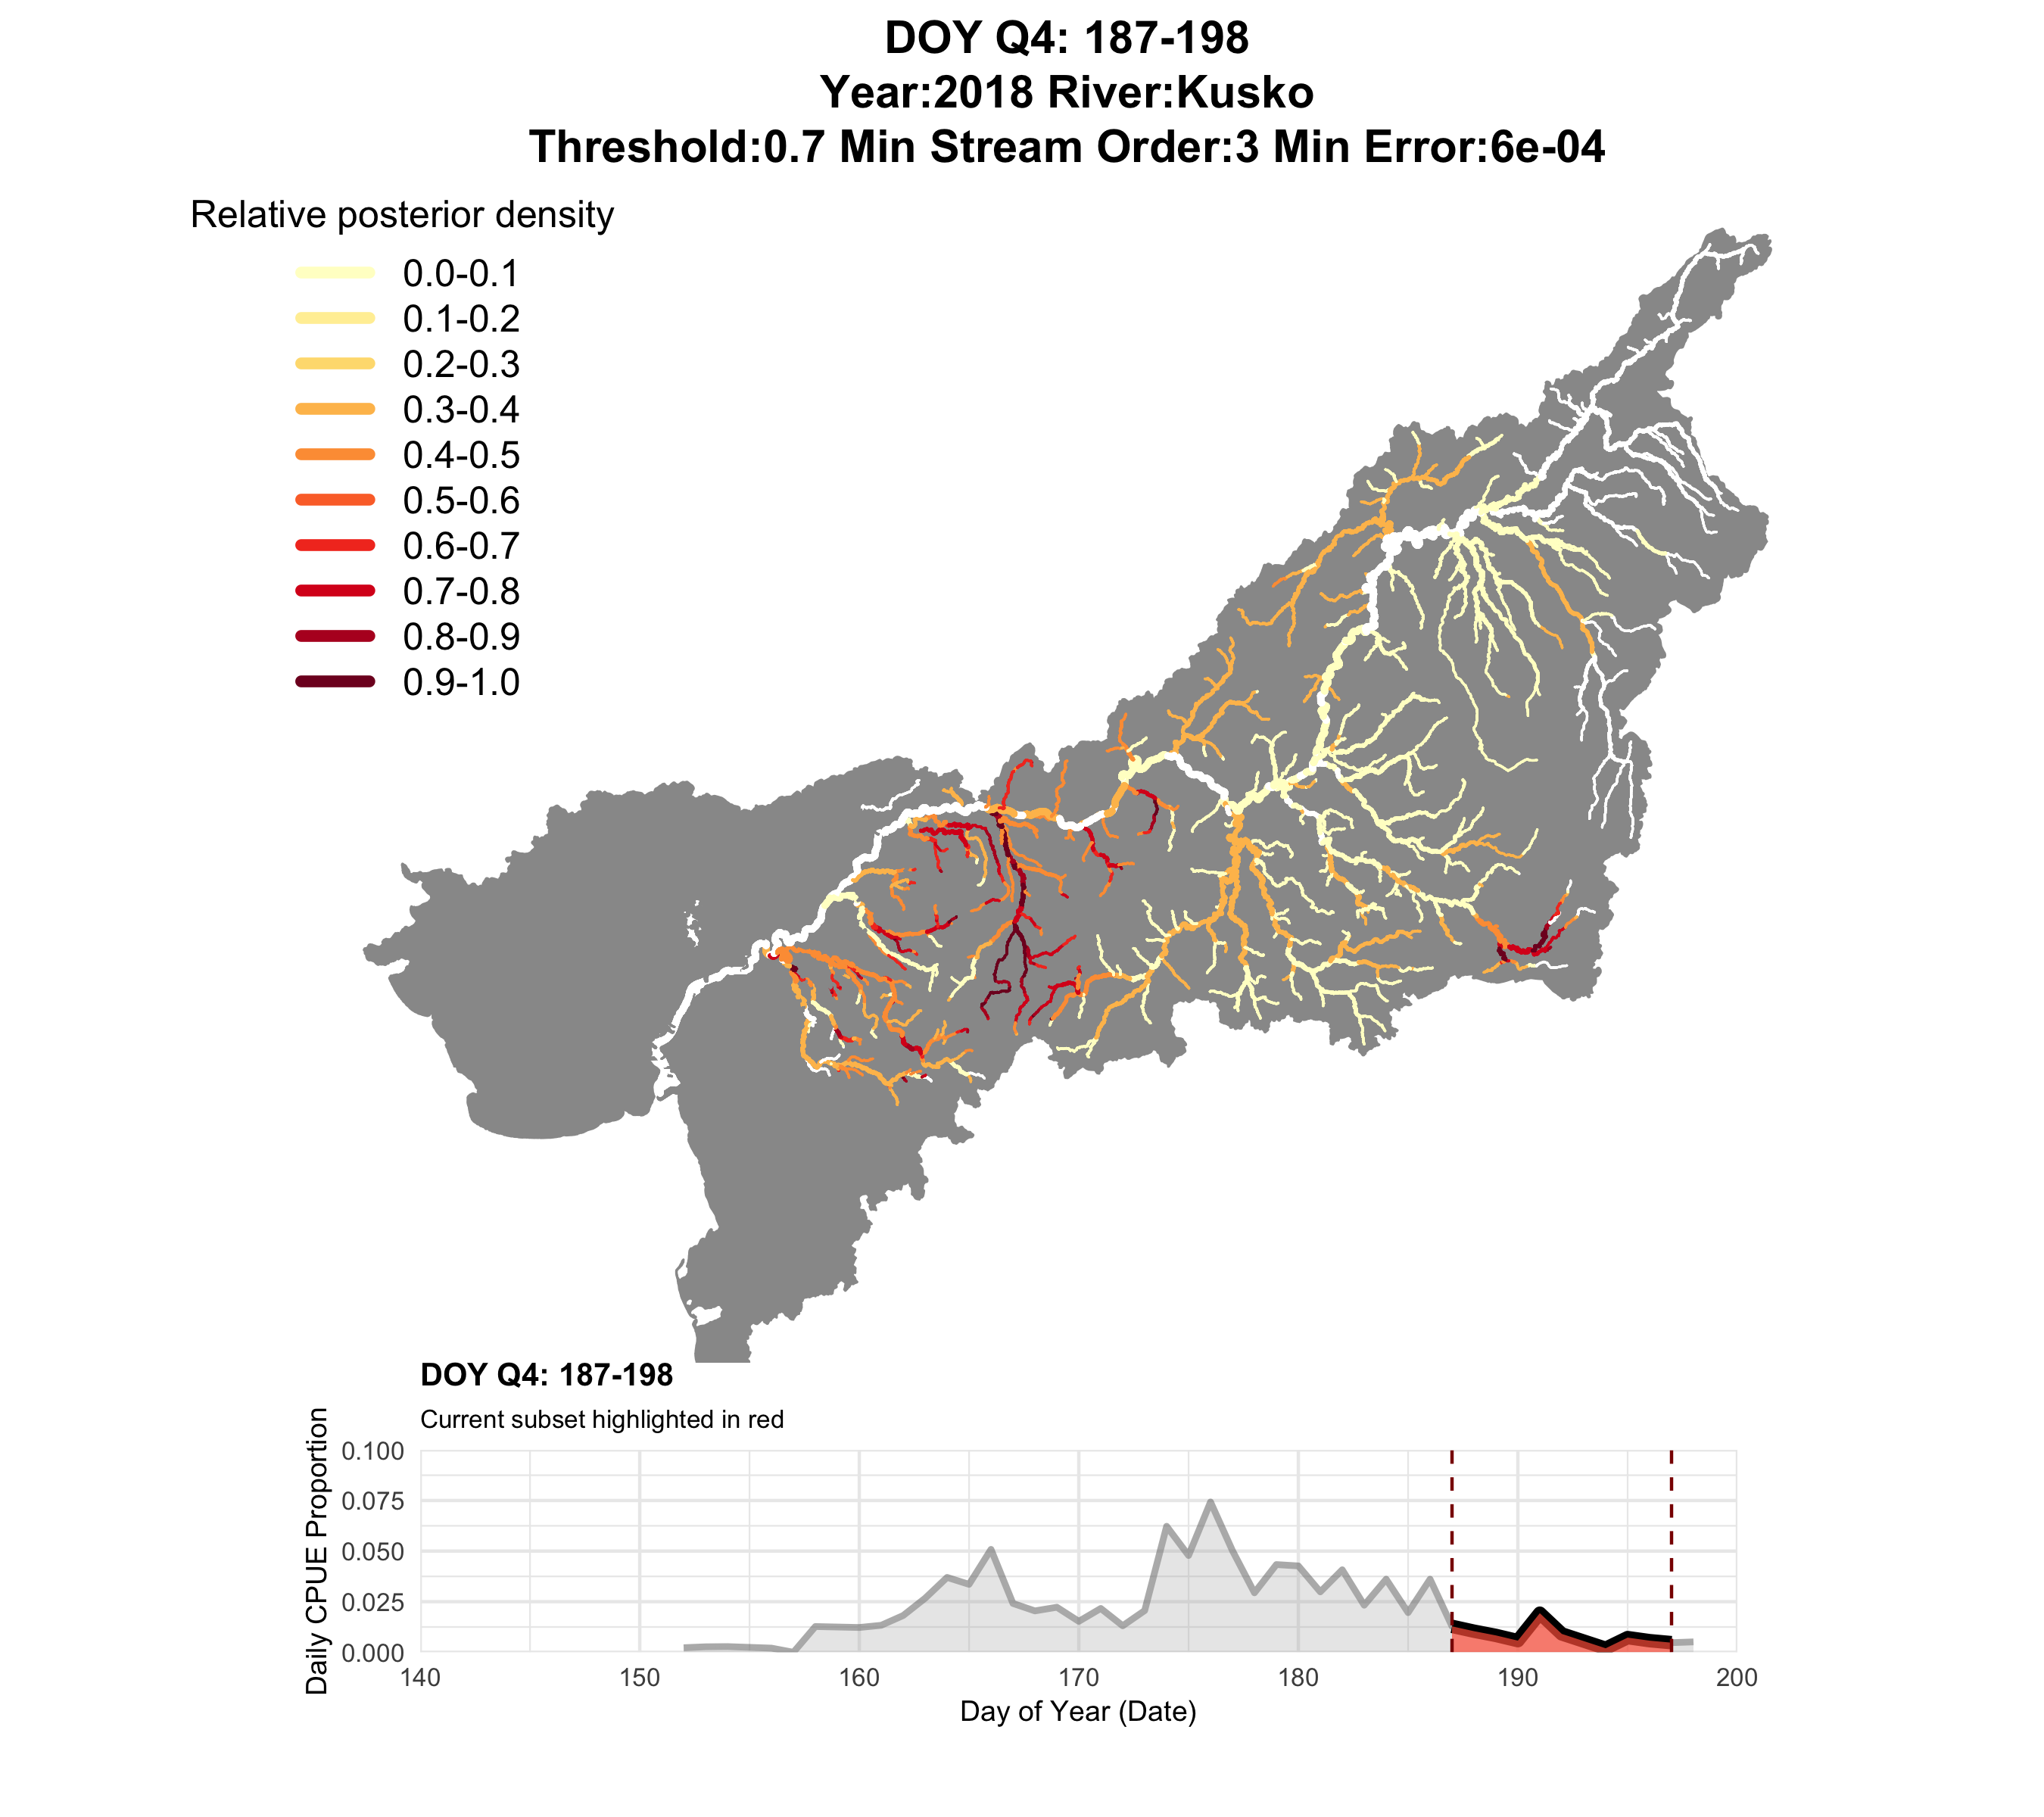
2018
Q4

Slide 20
2018
Q4
Ecologically interesting, but too fine of a spatial scale for management…

Slide 21
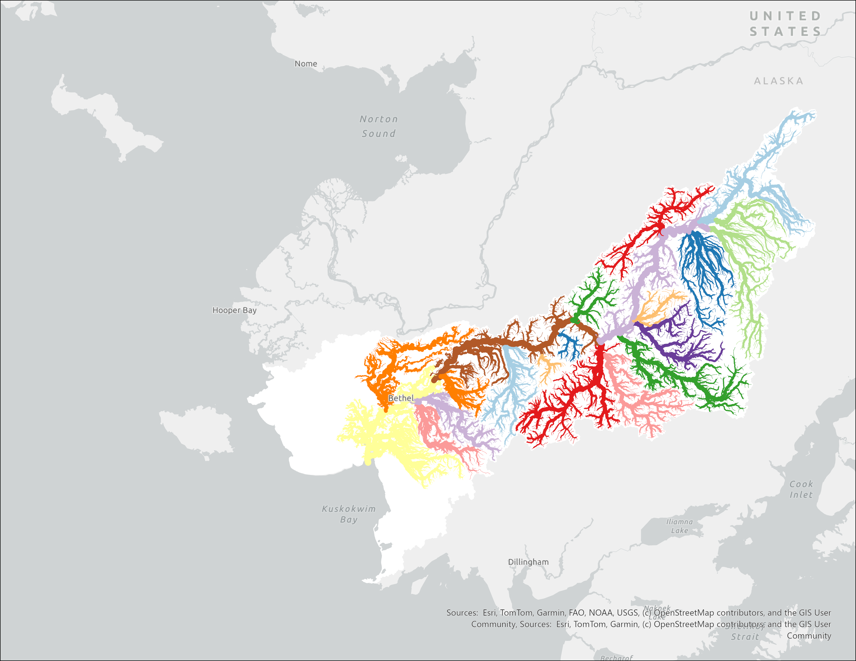
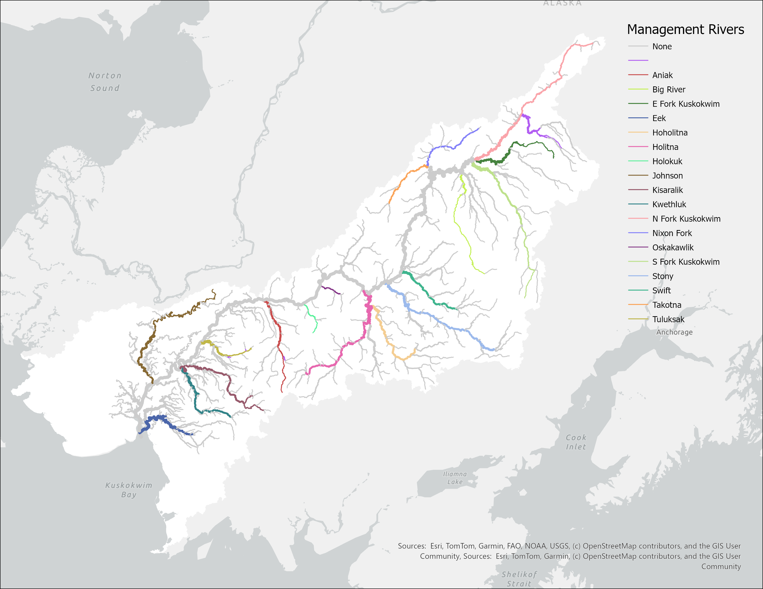

Slide 22
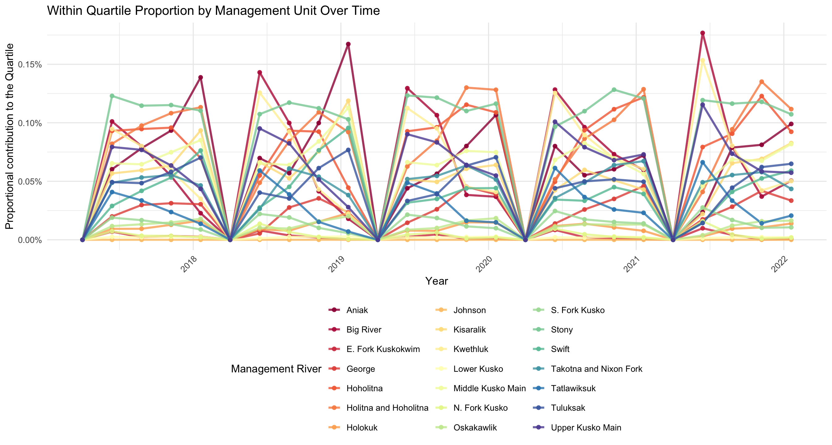
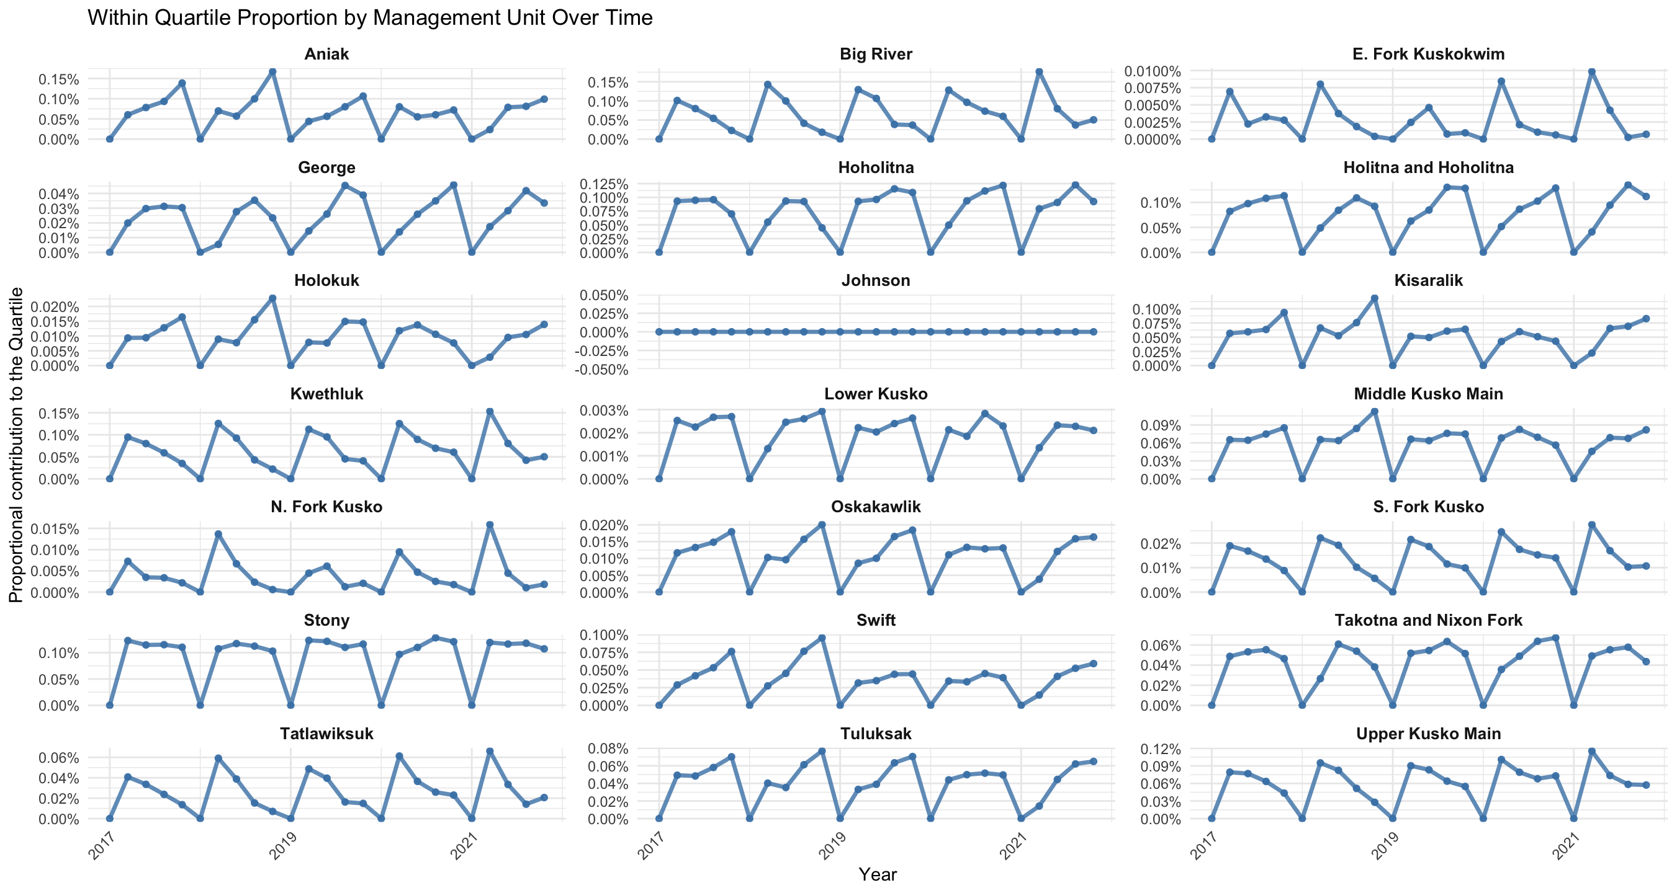
Relative contribution of each quartile

Slide 23
Relative contribution of each quartile

Slide 24
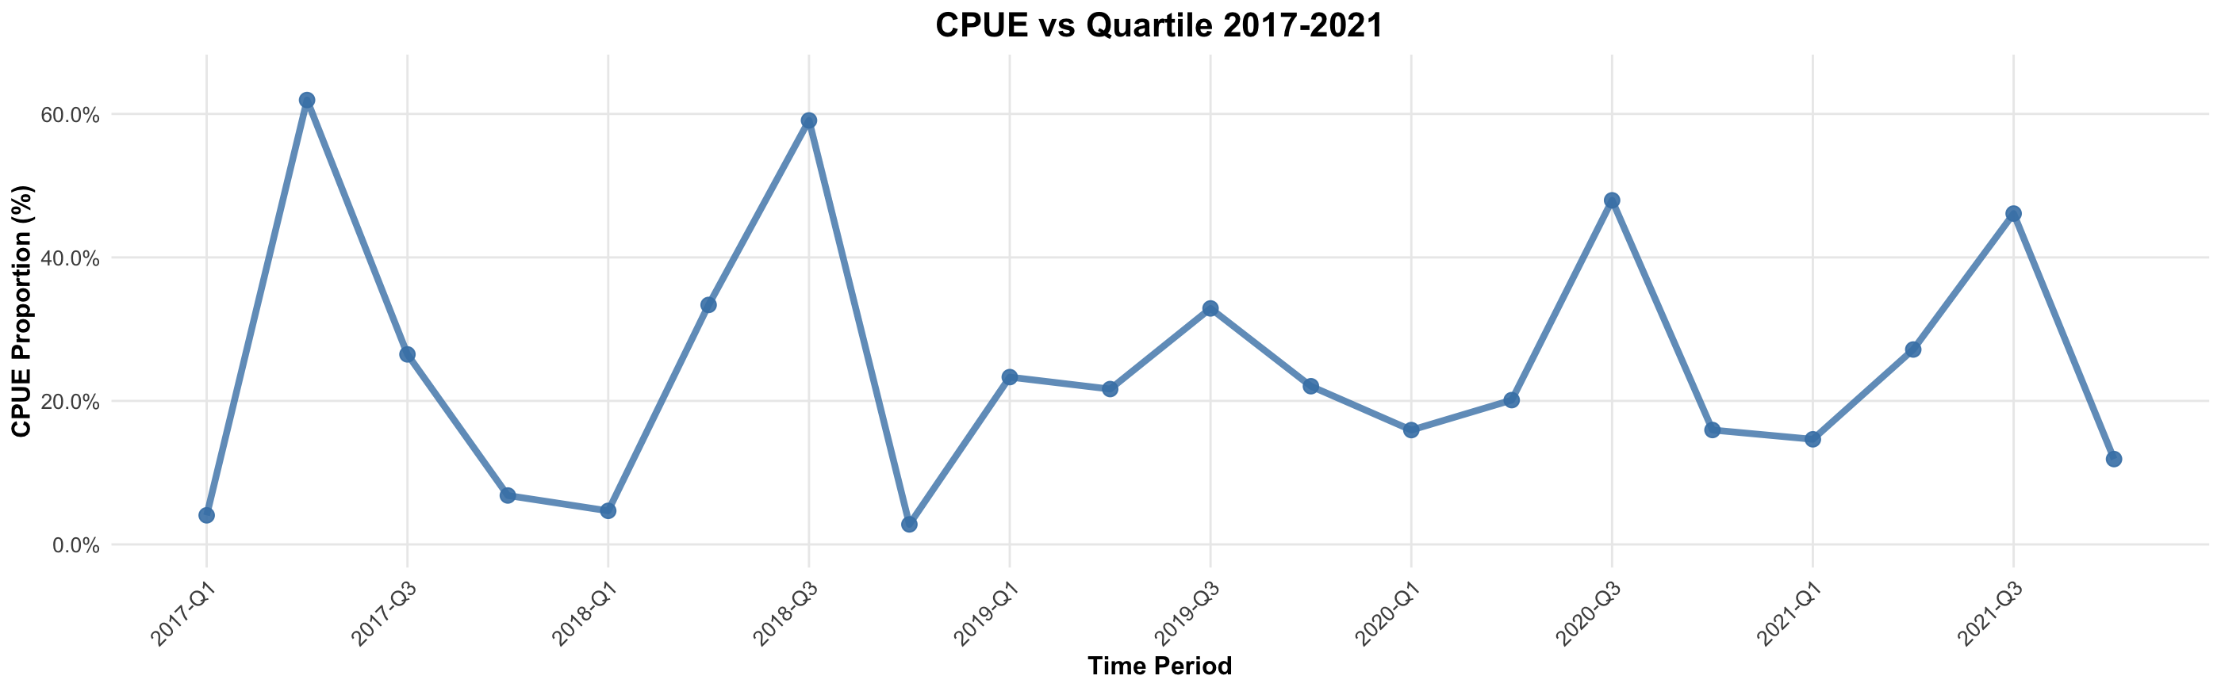
Covariates
Overall number of fish returning?
Potential covariates as hypotheses
Temporal distribution of when fish come in?

Slide 25
DATA PREP
Scaled all values from 0-1
Removed those with no variance/flat line (no production)

Slide 26
Dynamic Factor Analysis
Ts tool to identify common underlying trends in multivariate data.
Find shared patterns among quartiles
Test the effects of covariates on these shared patterns

Slide 27
Model Selection
m = 4 (4 Quartiles)
- tested others, but still sorting out alternative AIC…
R - “diagonal and unequal”
“diagonal and equal”
“equalvarcov”
Covariates = “CPUE, Run.Size, CPUE AND Run.Size, None”
Z matrix = * none specified*
A matrix = *none specified* , values are normalized to 0-1
U = “zero”
Although there may be trends, I don’t expect significant changes over such a short timeseries.

Slide 28
Model Selection
m = 4 (4 Quartiles)
- tested others, but still sorting out alternative AIC…
R - “diagonal and unequal”
“diagonal and equal”
“equalvarcov”
Covariates = “CPUE, Run.Size, CPUE AND Run.Size, None”
Z matrix = * none specified*
A matrix = *none specified* , values are normalized to 0-1
U = “zero”
Although there may be trends, I don’t expect significant changes over such a short timeseries.

Slide 29
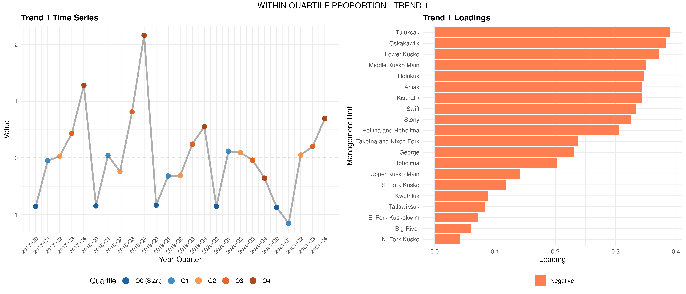
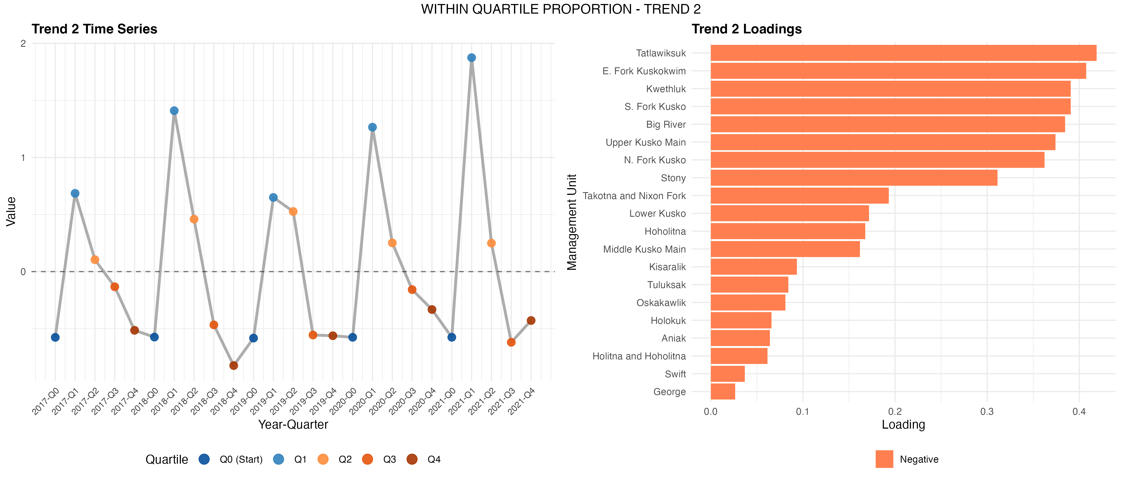
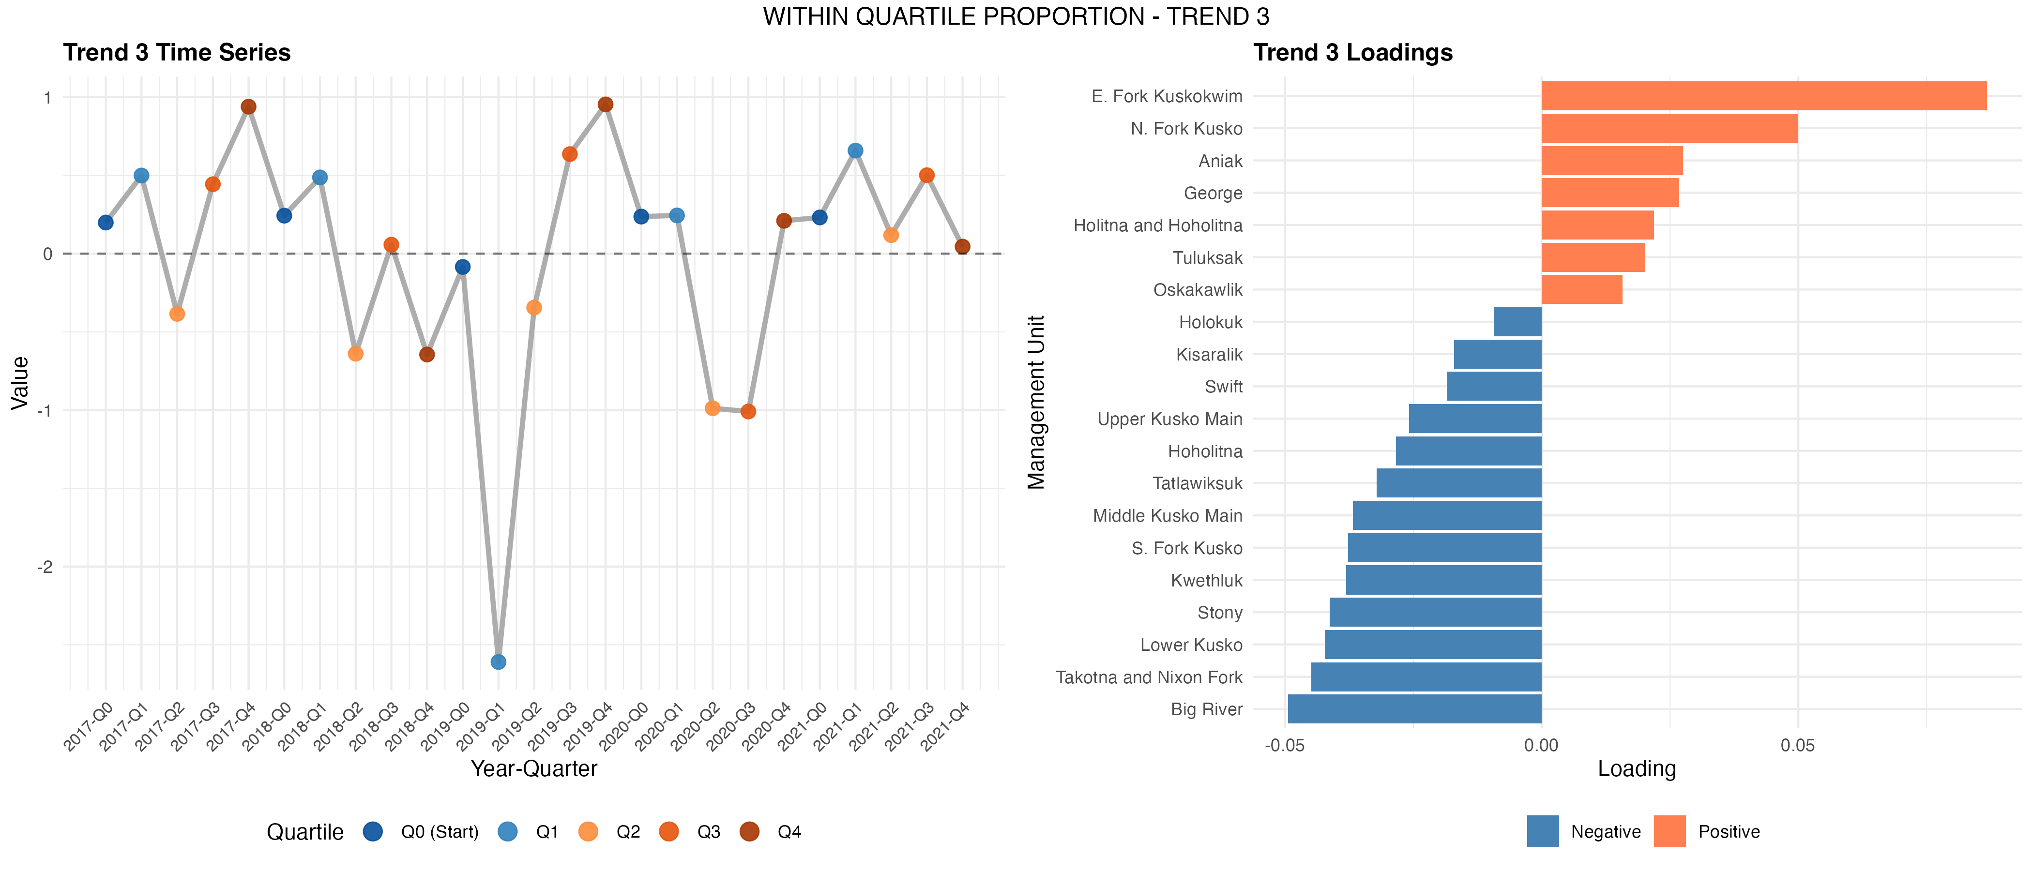
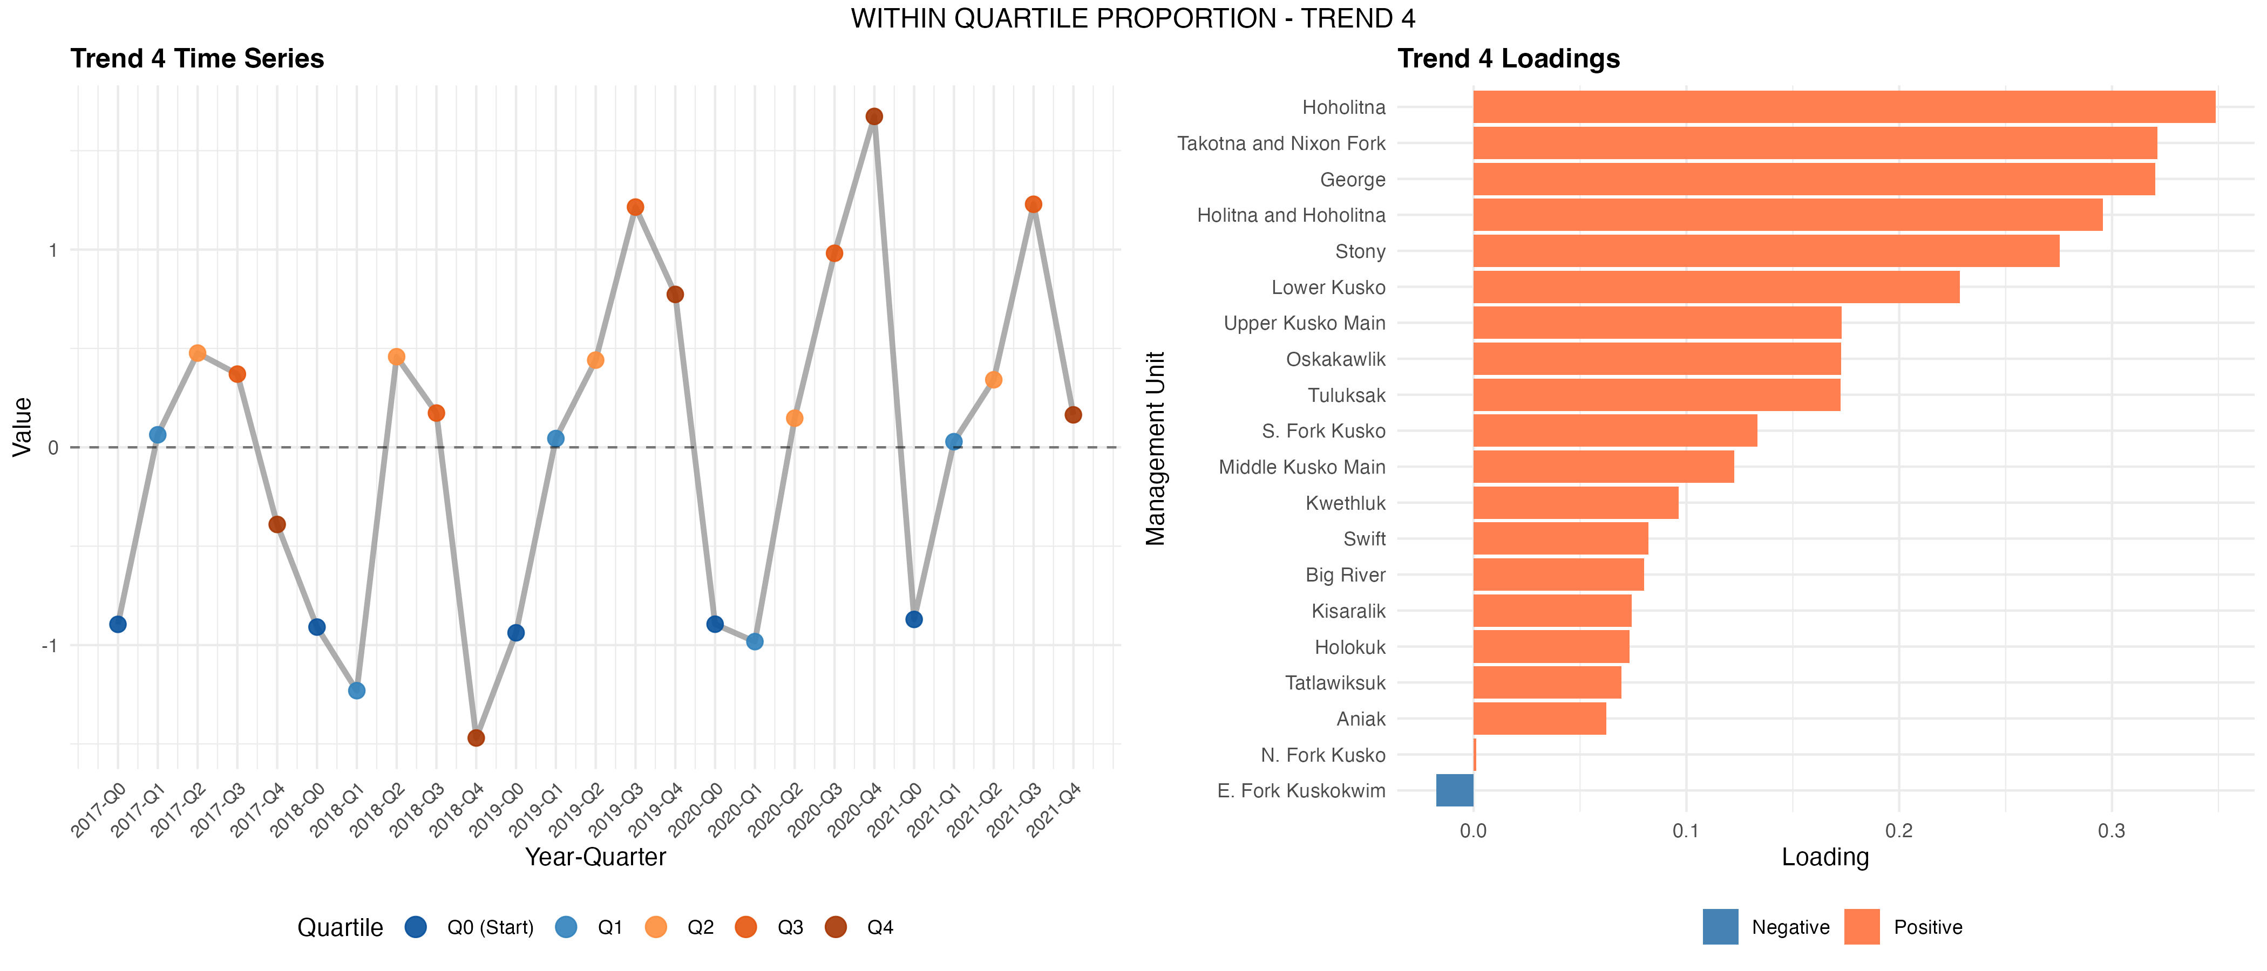
Results *After varimax rotation*

Slide 30
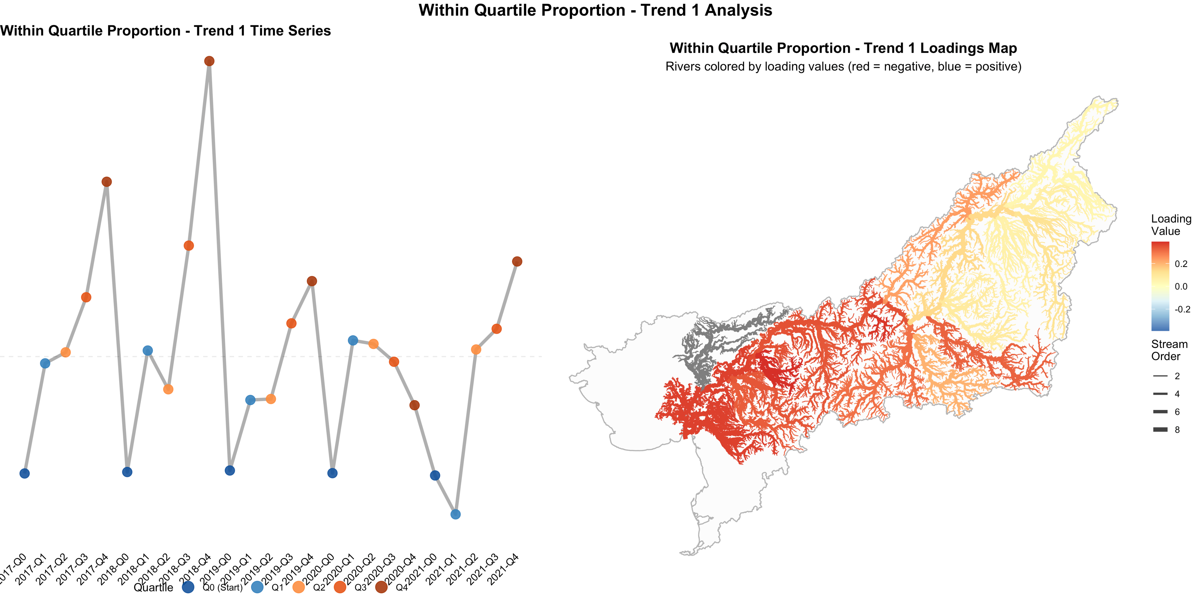
Strong contribution from the 4th Q in the beginning of the dataset.
Noticeable decrease towards the end

Slide 31
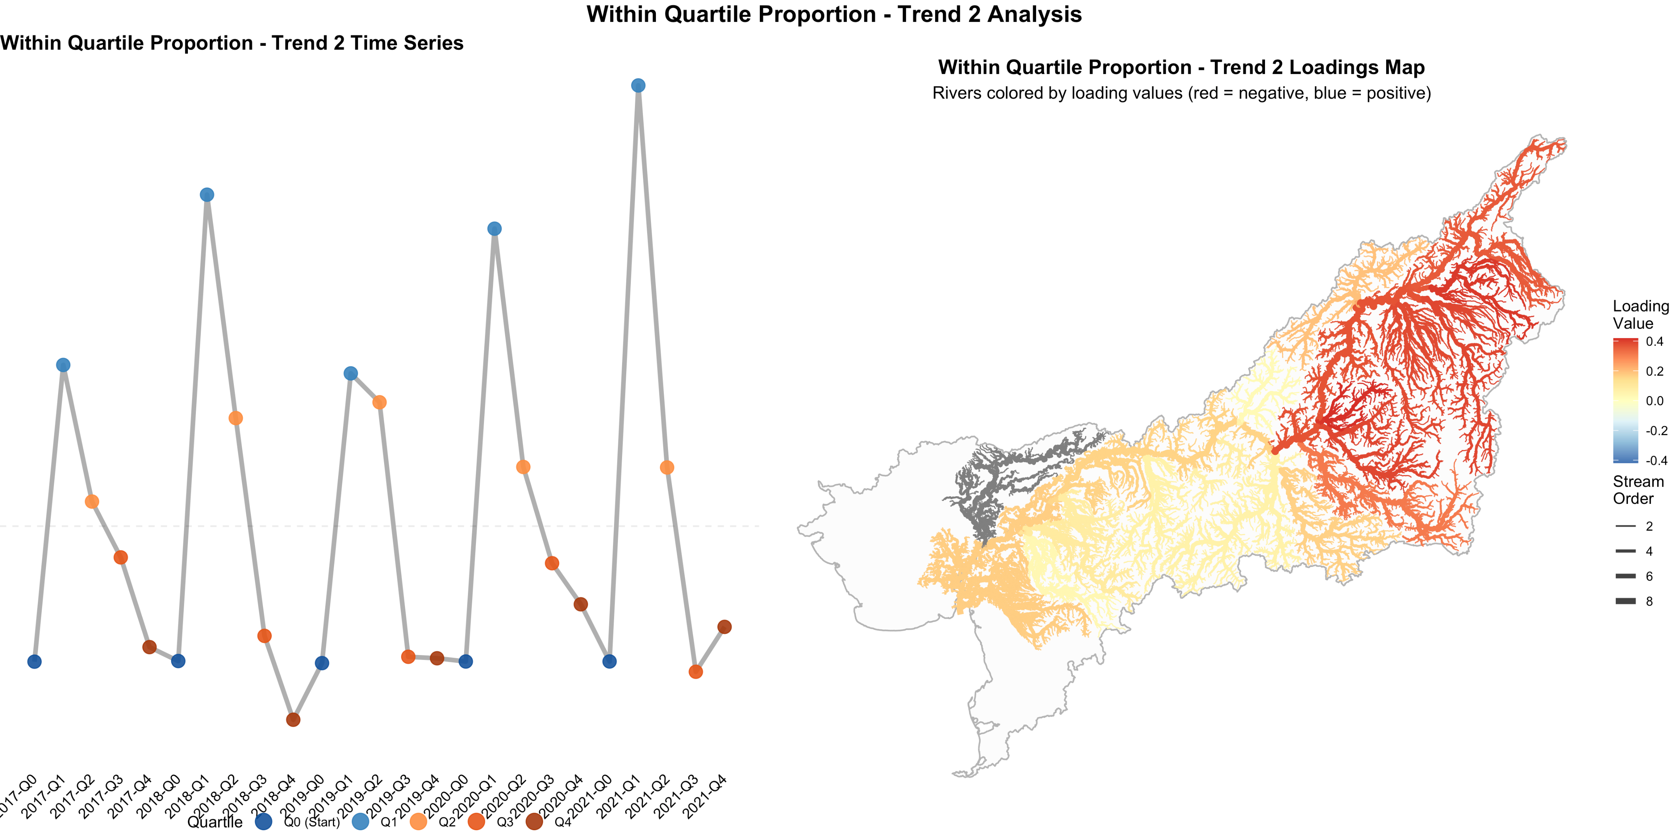
Strong contribution in the 1st Q
If anything, increasing

Slide 32
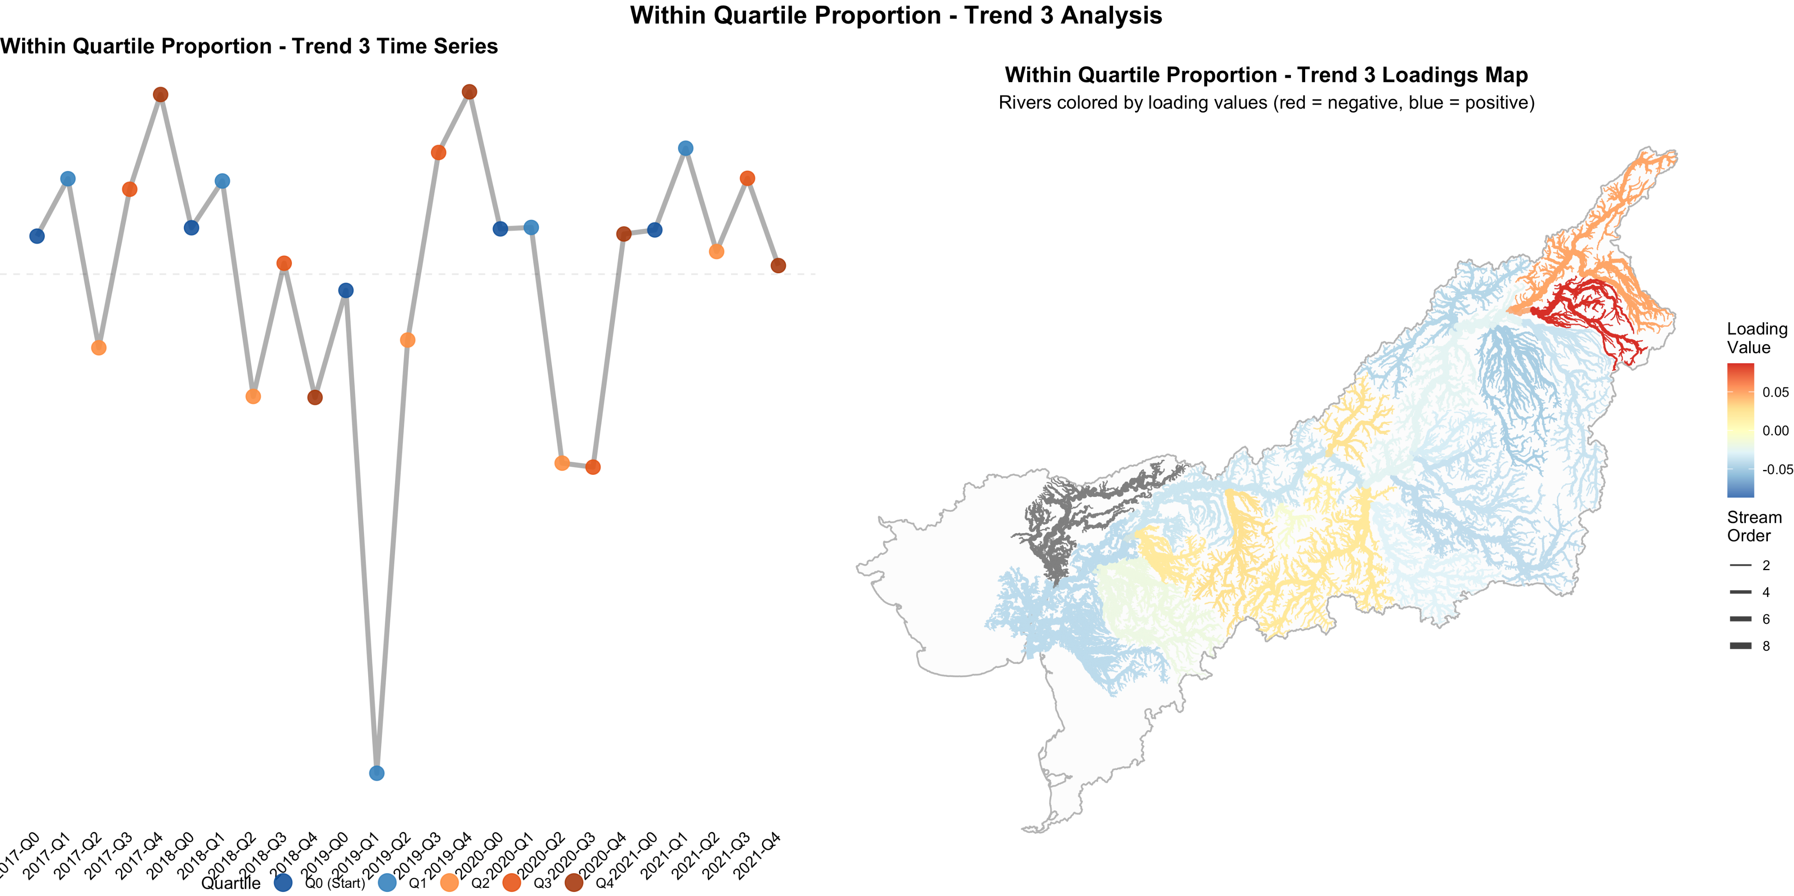
Lots of variation, but areas of little/weak covariance

Slide 33
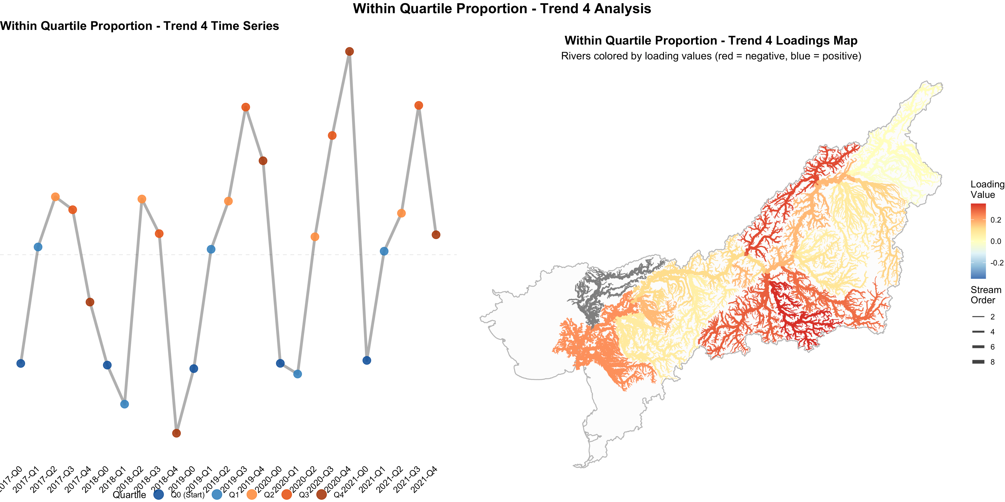
Increase in proportional contribution of these regions to the late run over time

Slide 34
Shift in production to these tributaries in the late run?

Slide 35
Conclusion
DFA was able to
identify shared trends and show where covariance occurs in the basin
Identify overall change in these trends over the dataset
This allows us to
Suggest potential impact of a front end closure
Identify natural variability in spatiotemporal patterns contributing towards portfolio effect

Slide 36
Thank you!

